Slide 1
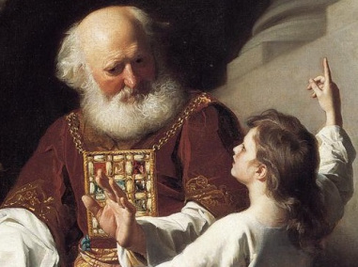
‘Hearing God’s voice’, 29th April & 1st May 2020
A Presentation prepared by Fr. Gabor Czako (based on DPM radio talks, Bible & own experience)
St. Peter’s & Sacred Heart Roman Catholic Churches
3 Chapel Court, Justice Street, Aberdeen AB11 5HX, tel: 01224621581
1780 Painting, Samuel Reading to Eli the Judgments of God Upon Eli’s House

Slide 3
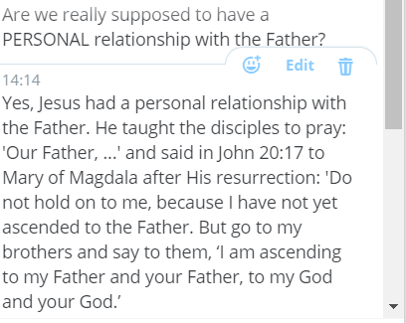
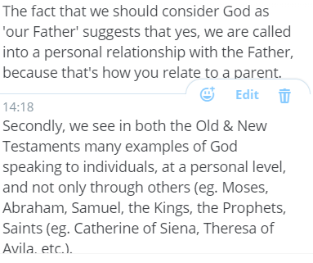

Slide 4
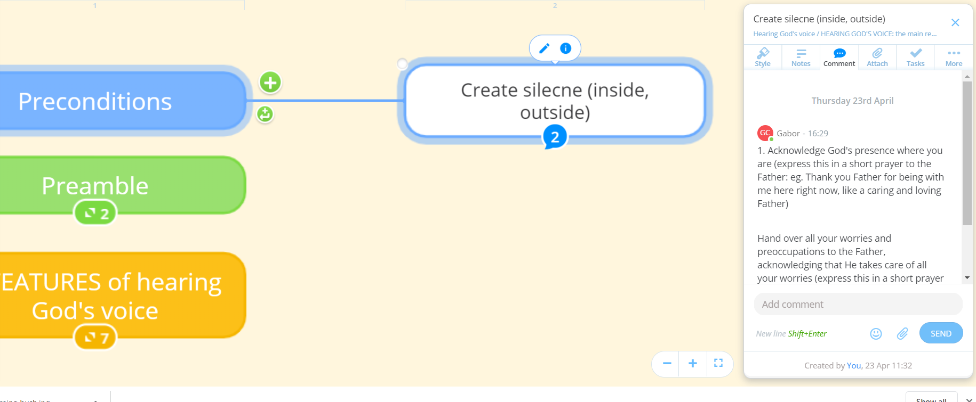
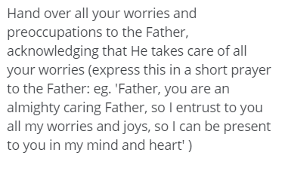

Slide 5
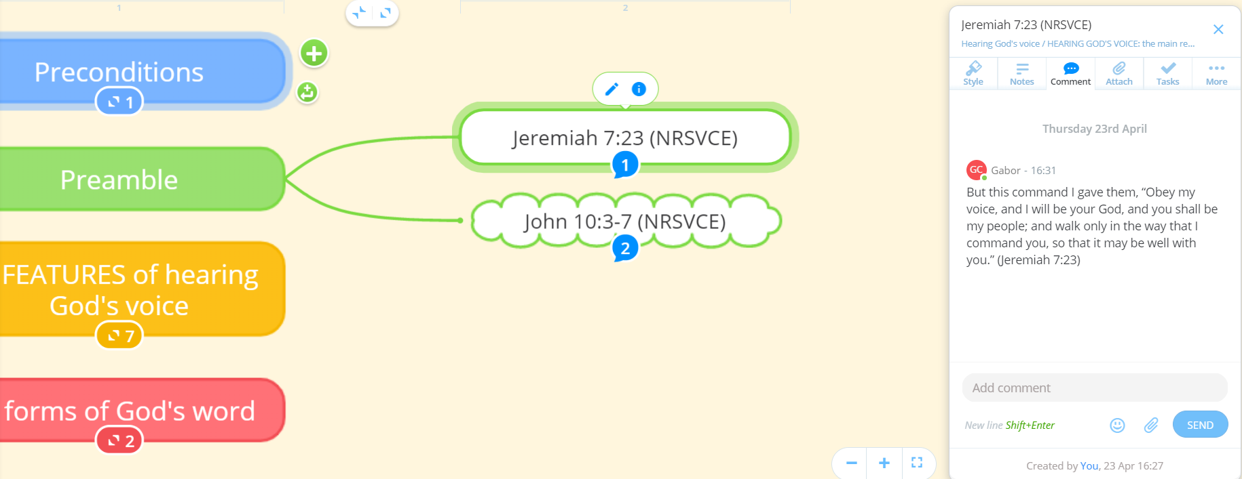
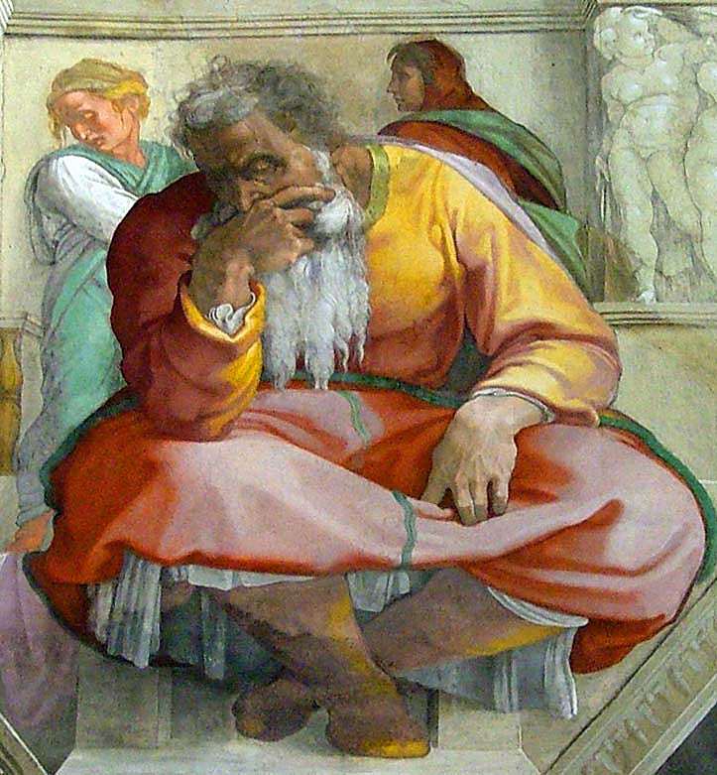

Slide 6
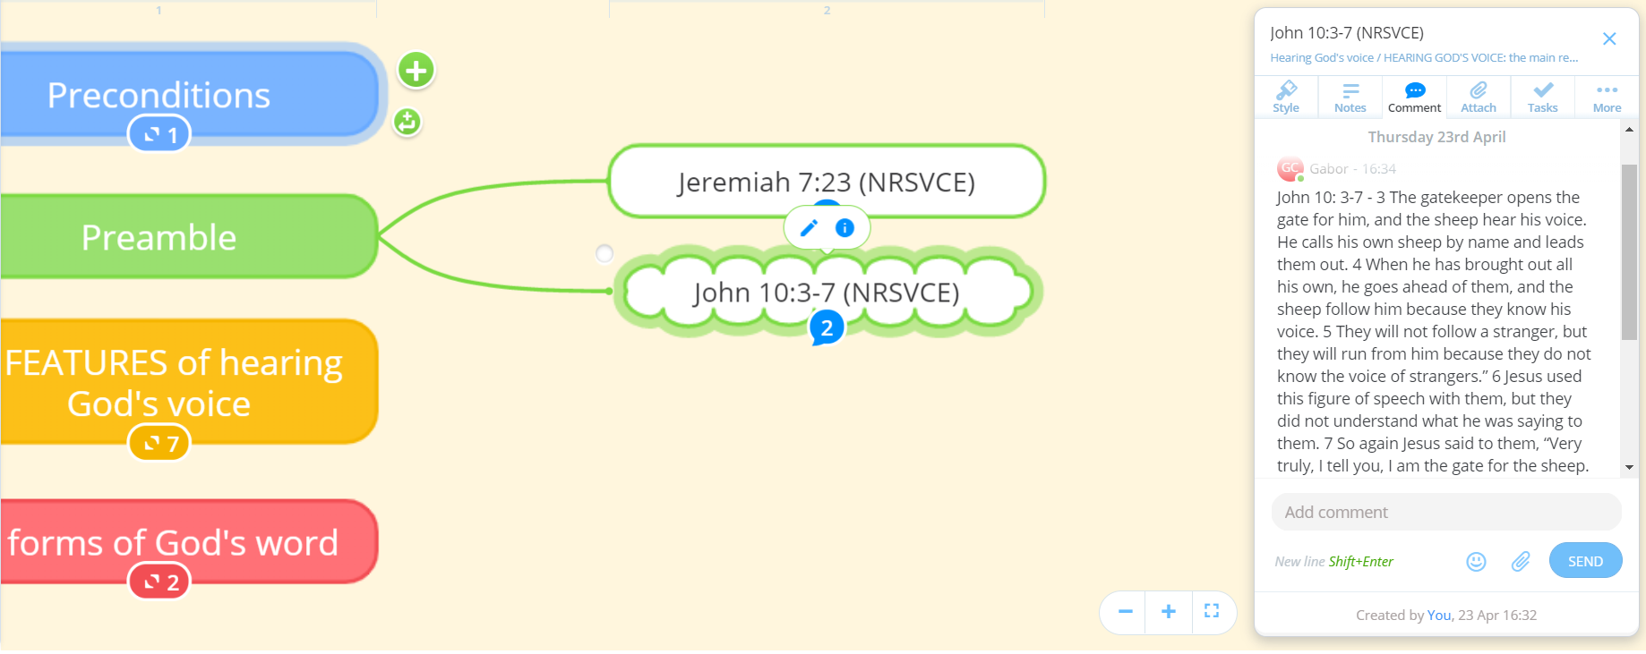
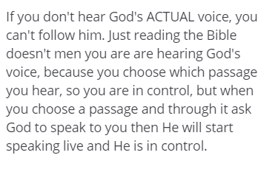

Slide 7
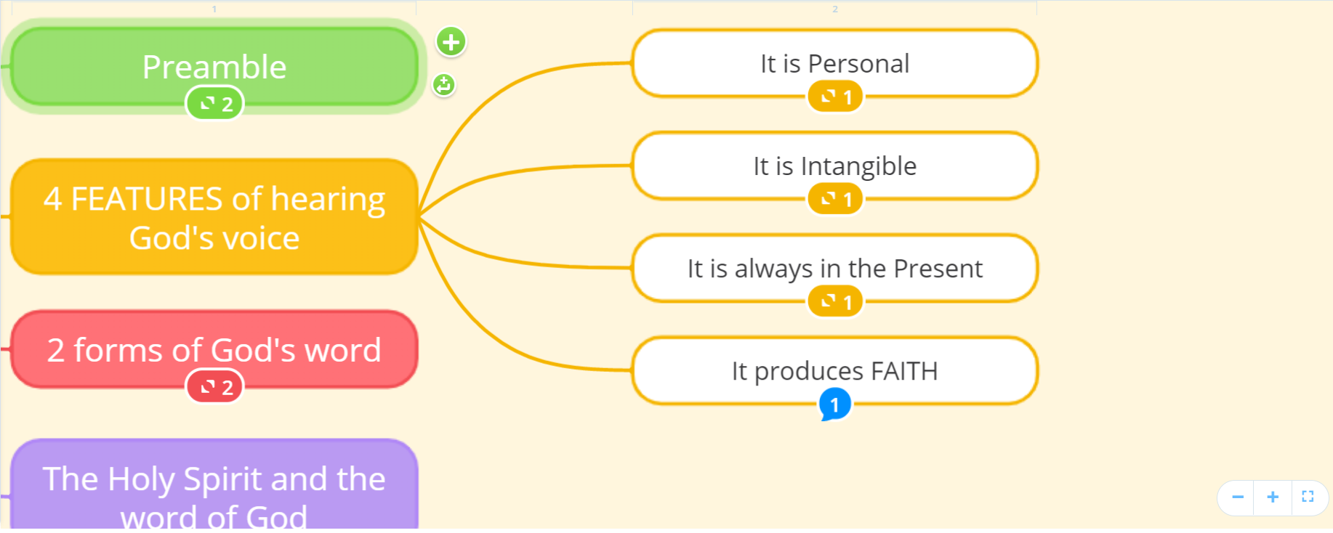

Slide 8
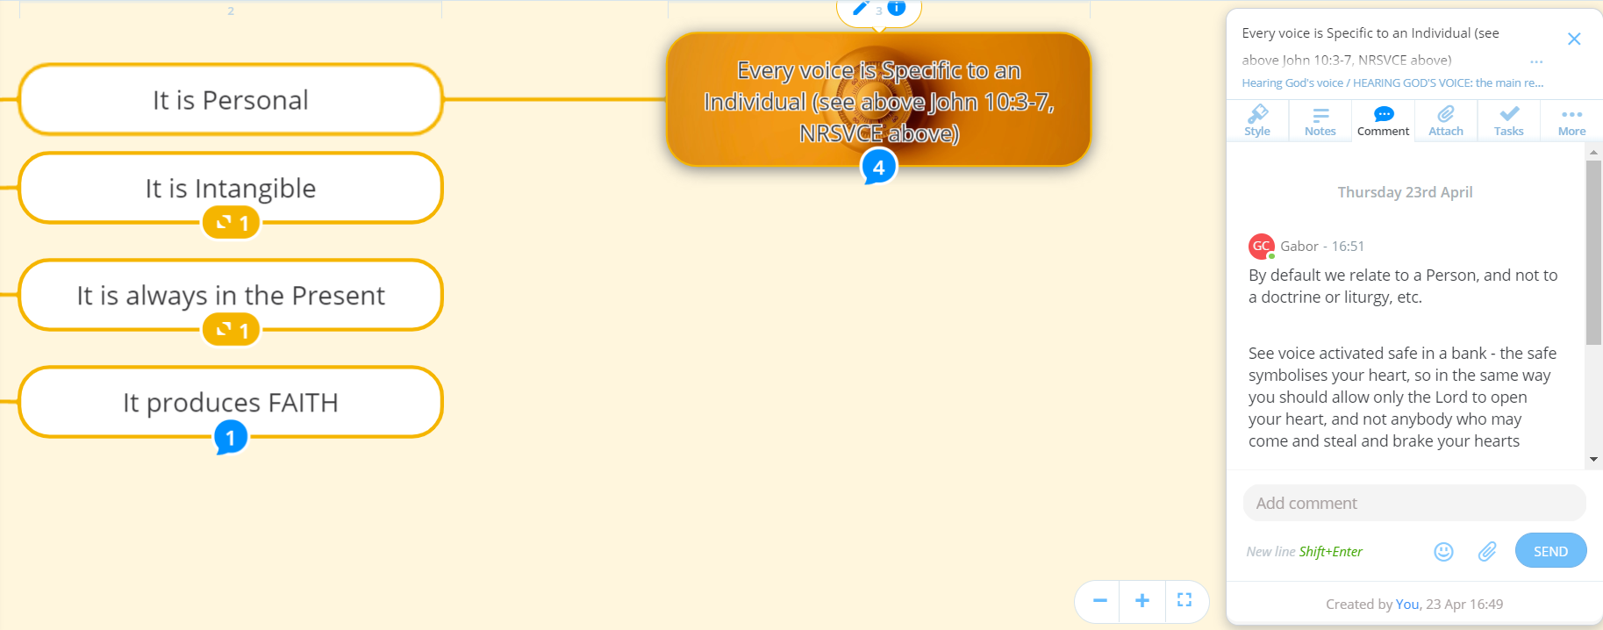
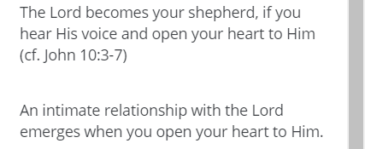

Slide 14
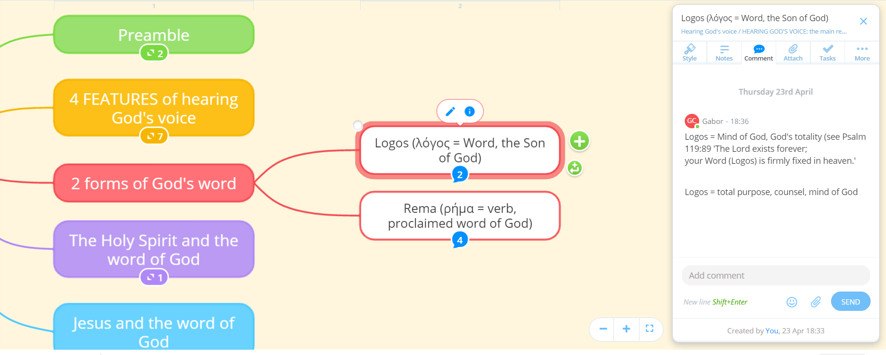

Slide 15
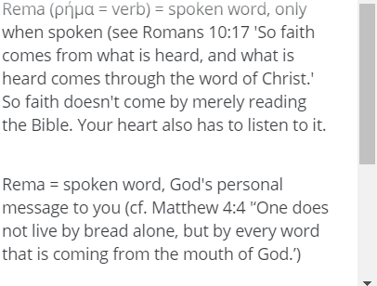
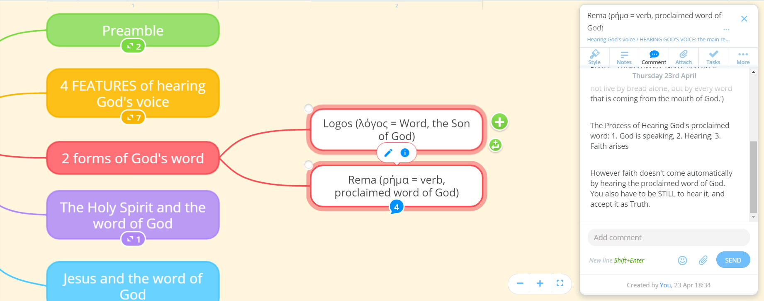

Slide 16
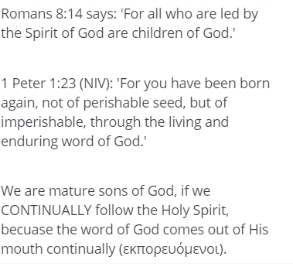
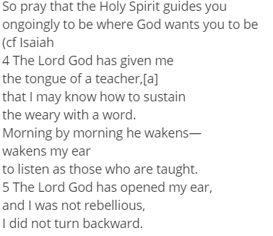
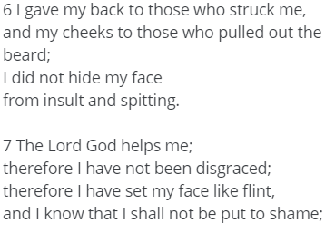

Slide 17
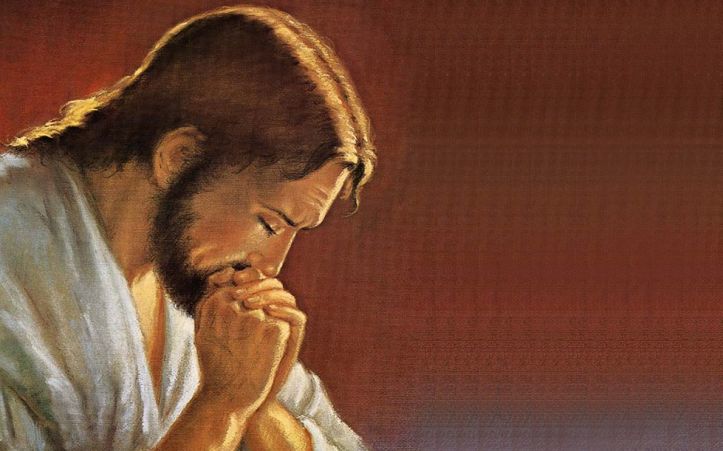
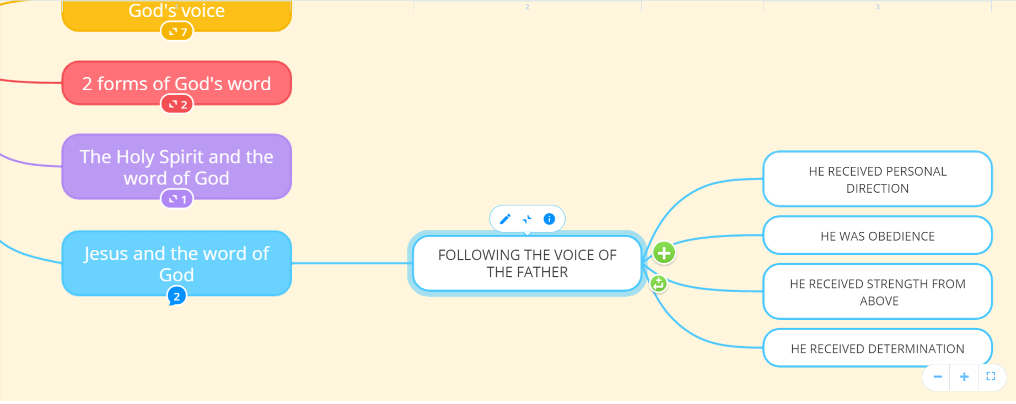

Slide 20
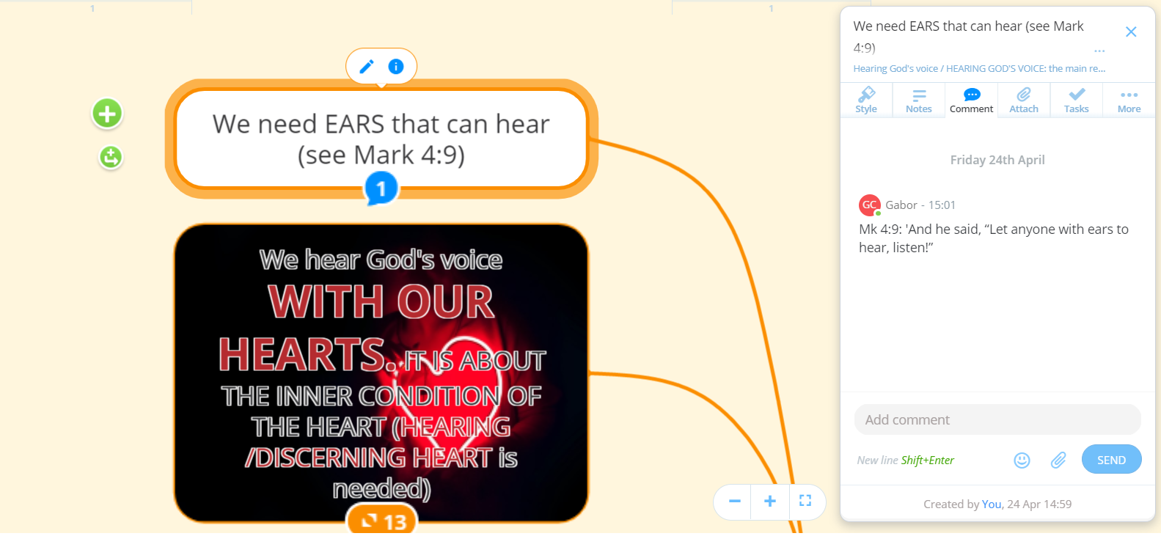

Slide 21
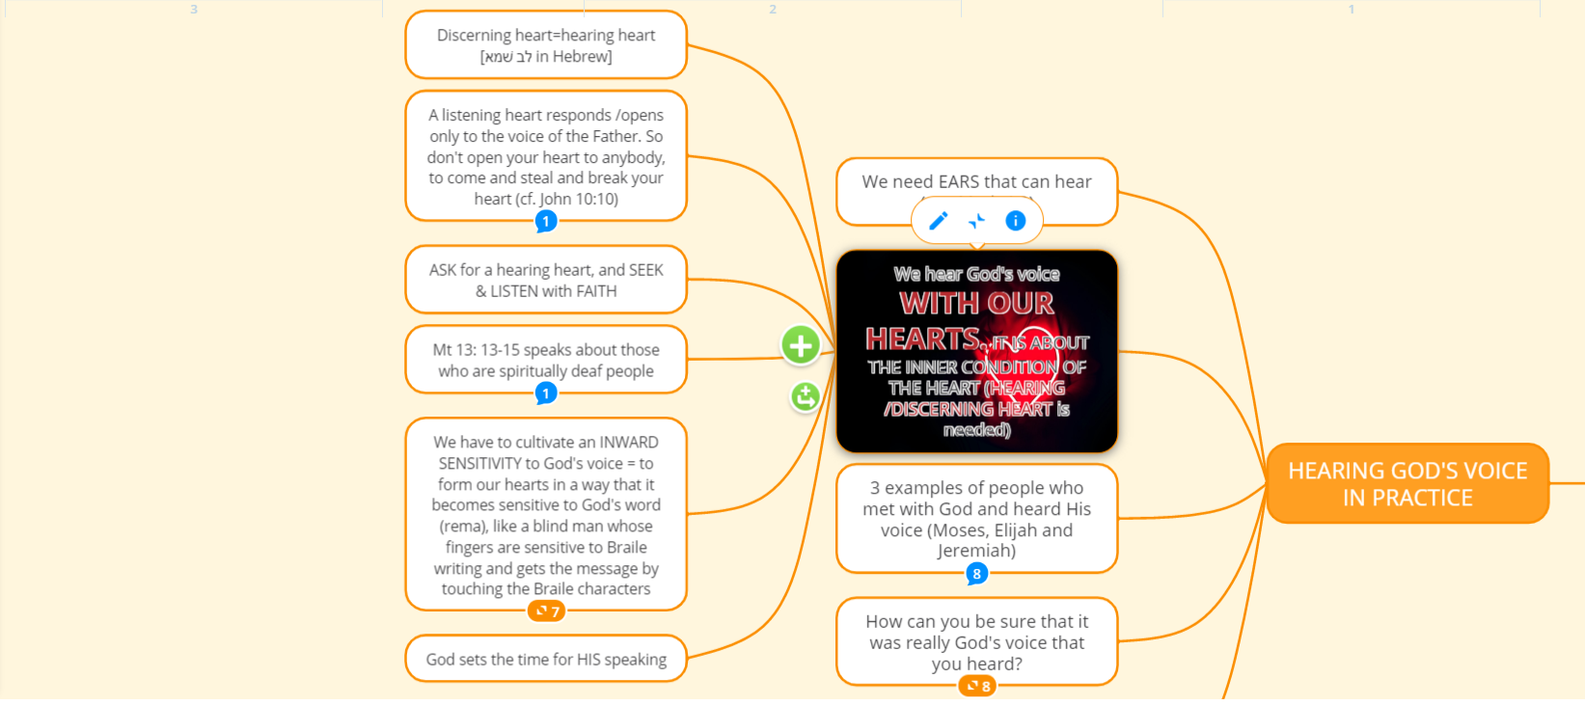

Slide 22
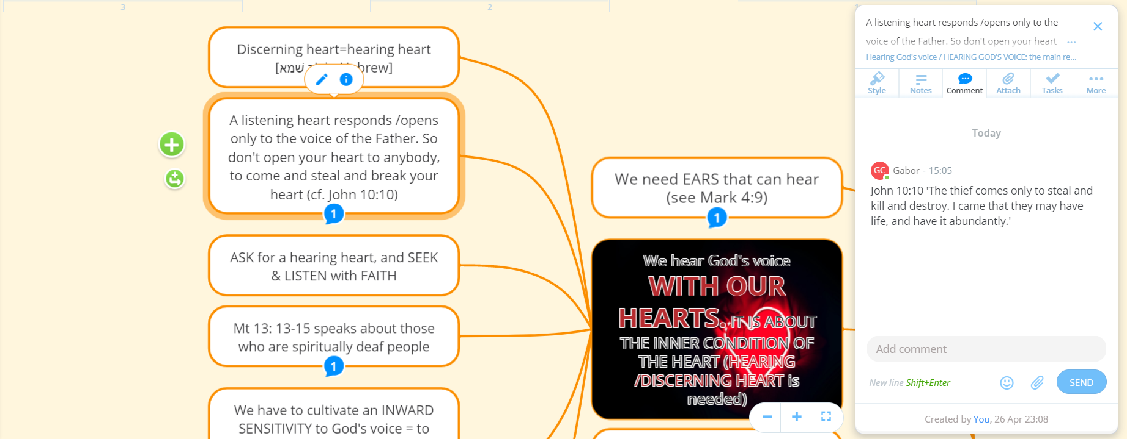

Slide 24
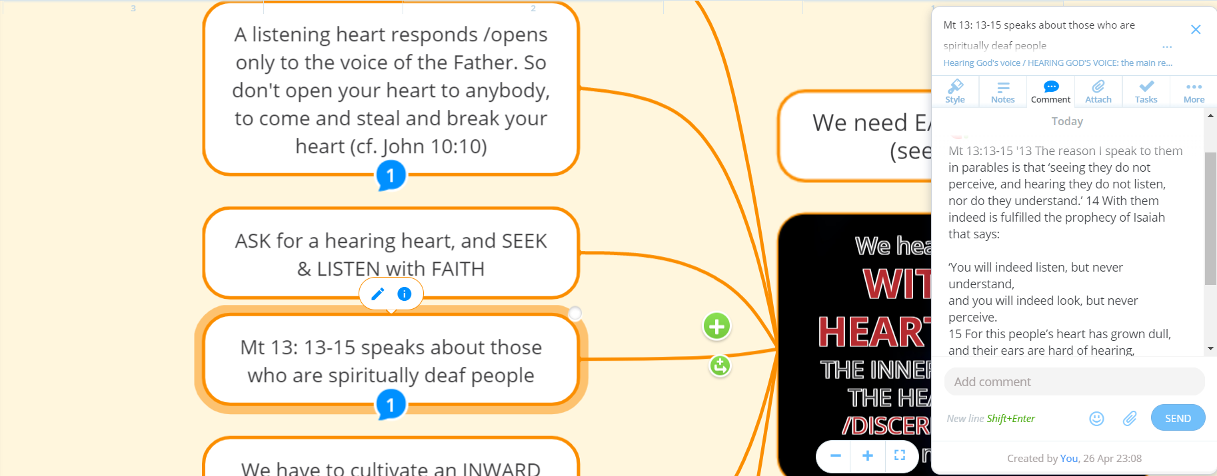

Slide 25
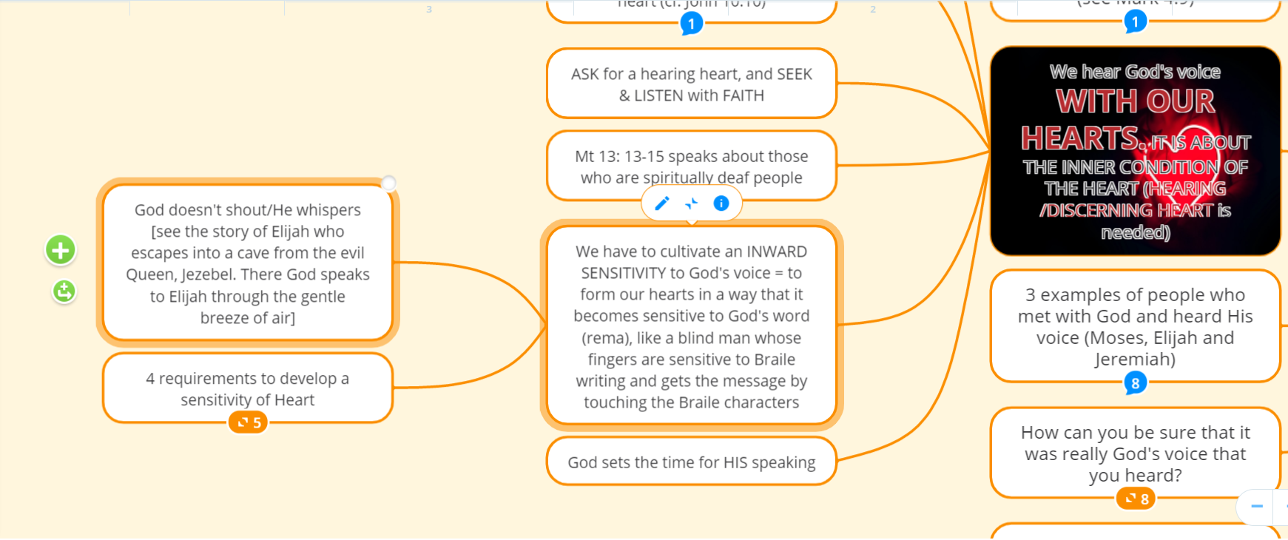

Slide 26
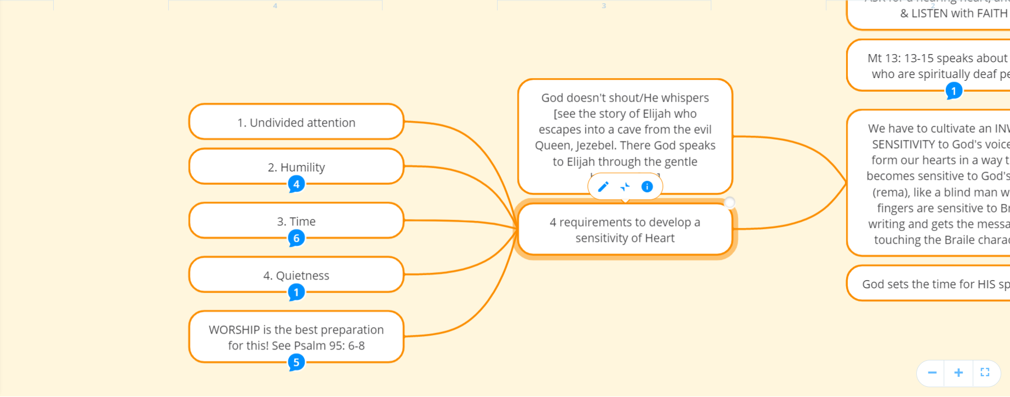

Slide 27
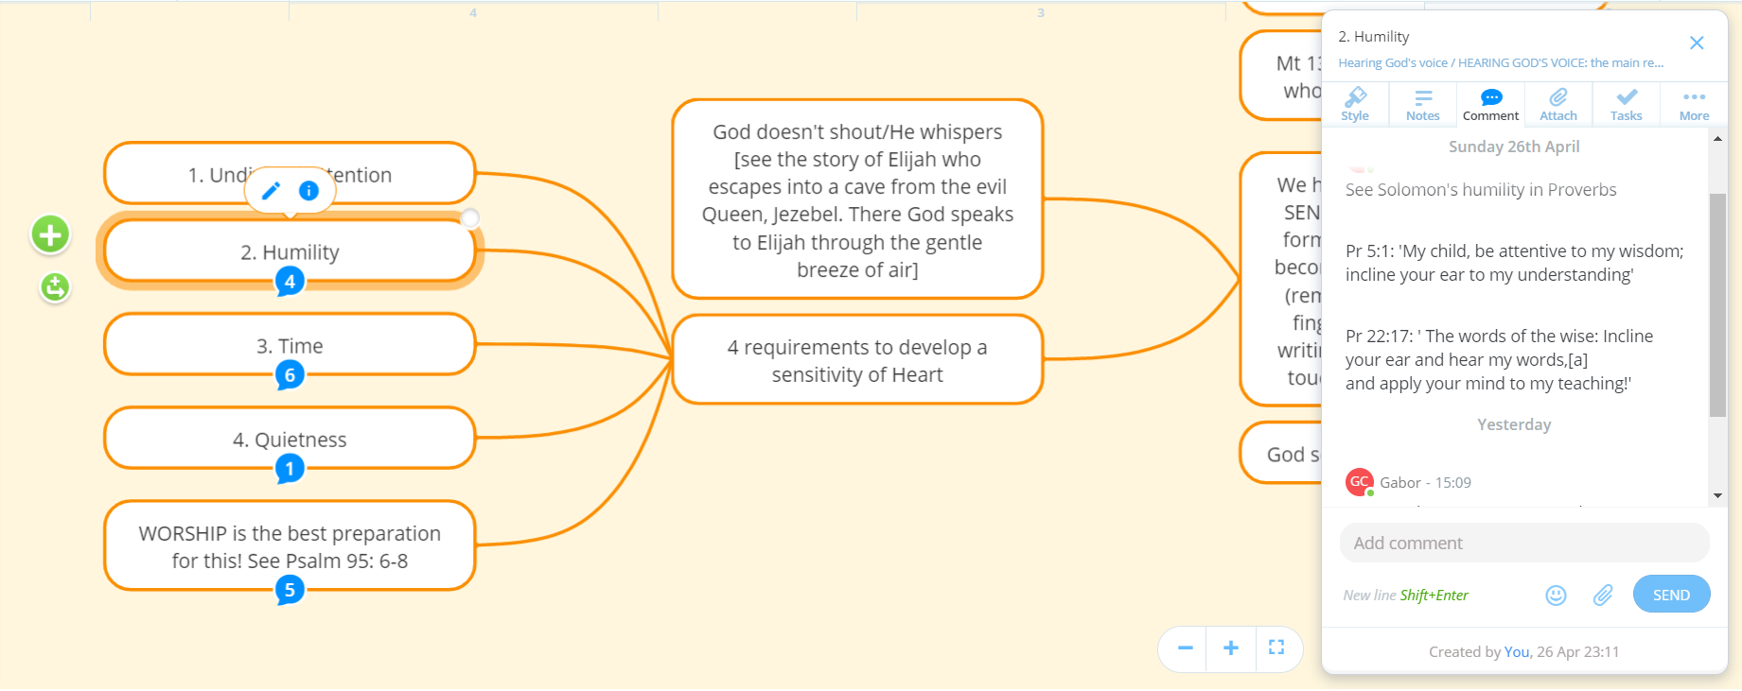

Slide 28
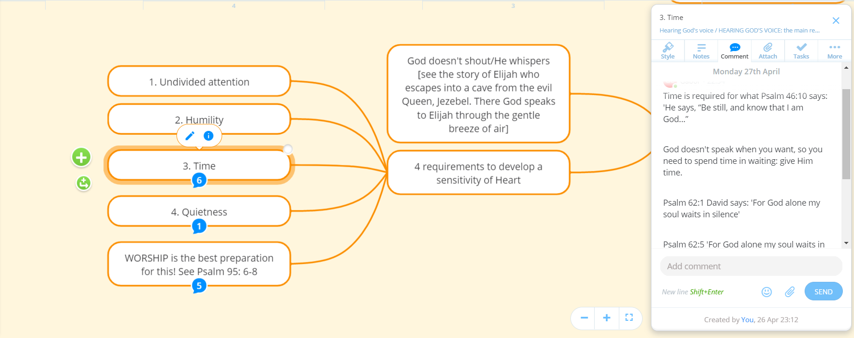
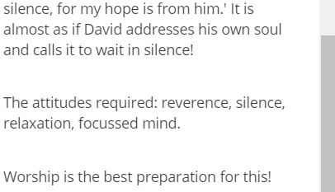

Slide 29
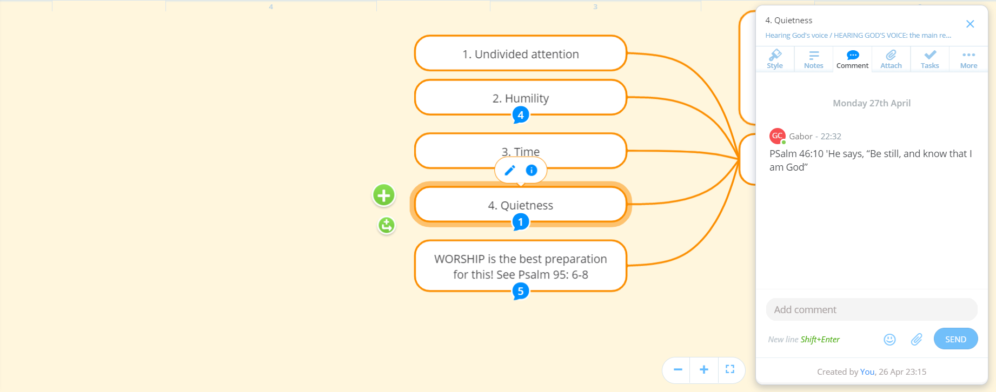

Slide 30
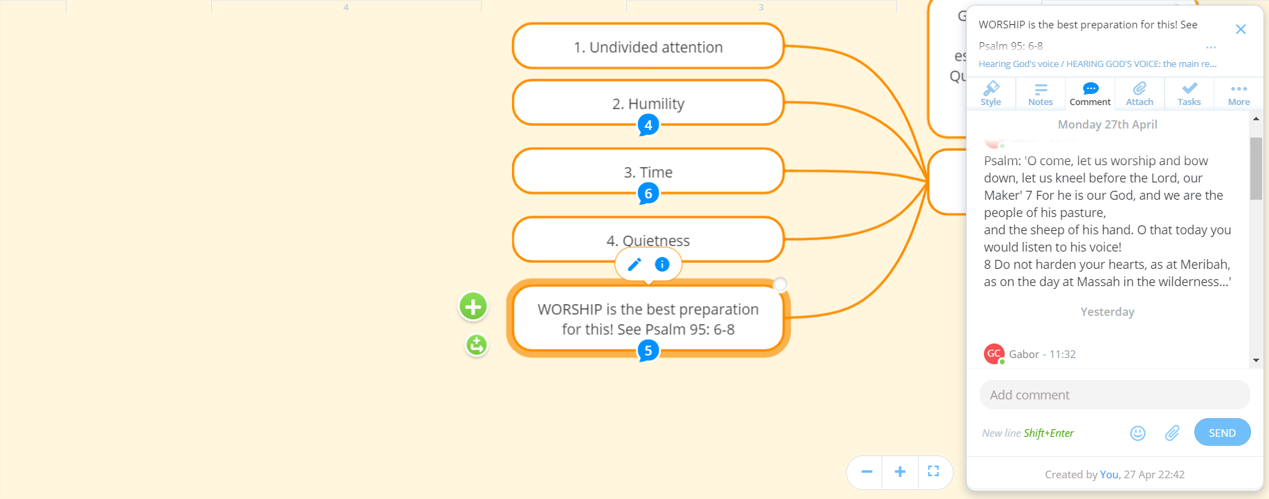
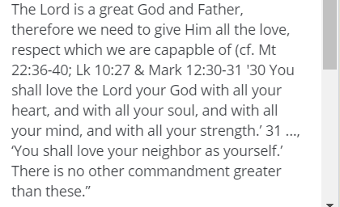
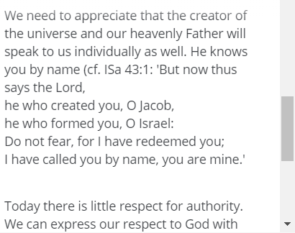

Slide 31
Moses in Numbers 7:89 'When Moses went into the tent of meeting to speak with the Lord,[a] he would hear the voice speaking to him from above the mercy seat[b] that was on the ark of the covenant[c] from between the two cherubim; thus it spoke to him.' Moses went into the tent of the Taberancle - from the heat and business with the people into the coolness and peace of the tent inside, a quiet place where you can hear God in a relaxed and quiet place. It was a place of praise, worship, mercy, etc. It is a bit like when Jesus tells you in Mt 6:6: 'But whenever you pray, go into your inner room and shut the door and pray to your Father who is in secret; and your Father who sees in secret will reward you.‘
'...your inner room...': all Christians have this inner room, where you hear God's voice - it is both a physical and spiritual room. Your inner room may be a room in the house, or a spot in a walking area, etc. but it is also your heart.
Elijah: After he had executed the false prophets of Jezebel he fled to Mt. Horeb into a cave. 1 Kings 19: 11-13: 'He said, “Go out and stand on the mountain before the Lord, for the Lord is about to pass by.” Now there was a great wind, so strong that it was splitting mountains and breaking rocks in pieces before the Lord, but the Lord was not in the wind; and after the wind an earthquake, but the Lord was not in the earthquake; 12 and after the earthquake a fire, but the Lord was not in the fire; and after the fire a sound of sheer silence. 13 When Elijah heard it, he wrapped his face in his mantle and went out and stood at the entrance of the cave. Then there came a voice to him that said, “What are you doing here, Elijah?”
A lot of people see God as a dictator, but His voice is gentle.
Elijah: After he had executed the false prophets of Jezebel he fled to Mt. Horeb into a cave. 1 Kings 19: 11-13: 'He said, “Go out and stand on the mountain before the Lord, for the Lord is about to pass by.
” Now there was a great wind, so strong that it was splitting mountains and breaking rocks in pieces before the Lord, but the Lord was not in the wind; and after the wind an earthquake, but the Lord was not in the earthquake; 12 and after the earthquake a fire, but the Lord was not in the fire; and after the fire a sound of sheer silence. 13 When Elijah heard it, he wrapped his face in his mantle and went out and stood at the entrance of the cave. Then there came a voice to him that said, “What are you doing here, Elijah?”
A lot of people see God as a dictator, but His voice is gentle.
'...wrapped his face in his mantle...' : it meant that Elijah prayed, praised God and worhsiped Him and bowed down his heart before Him.
So now He was ready to hear God's voice. So God carefully prepared Elijah to hear His voice.
Notice that God through His gentle voice gave strength and new direction to Elijah's ministry. When Elijah run to Mt. Horeb he was desparate, ready to give up and die, but after God had spoken to him Elijah got back His strength, his ministry received a new direction and went back to the town. God will do the same for you.
Jeremiah 18:1-6: '1The word that came to Jeremiah from the Lord: 2 “Come, go down to the potter’s house, and there I will let you hear my words.” 3 So I went down to the potter’s house, and there he was working at his wheel. 4 The vessel he was making of clay was spoiled in the potter’s hand, and he reworked it into another vessel, as seemed good to him.' 5 Then the word of the Lord came to me: 6 Can I not do with you, O house of Israel, just as this potter has done? says the Lord. Just like the clay in the potter’s hand, so are you in my hand, O house of Israel.' If you want to hear God's voice you have to obey God and be in a certain place at a certain time that He tells you (sounds like the visionaries of Medjugorje or Lourdes, etc.). God wanted Jeremiah to see what the potter was doing, and through that He told Jeremiah that this is how He will deal with the Israelites.

Slide 32
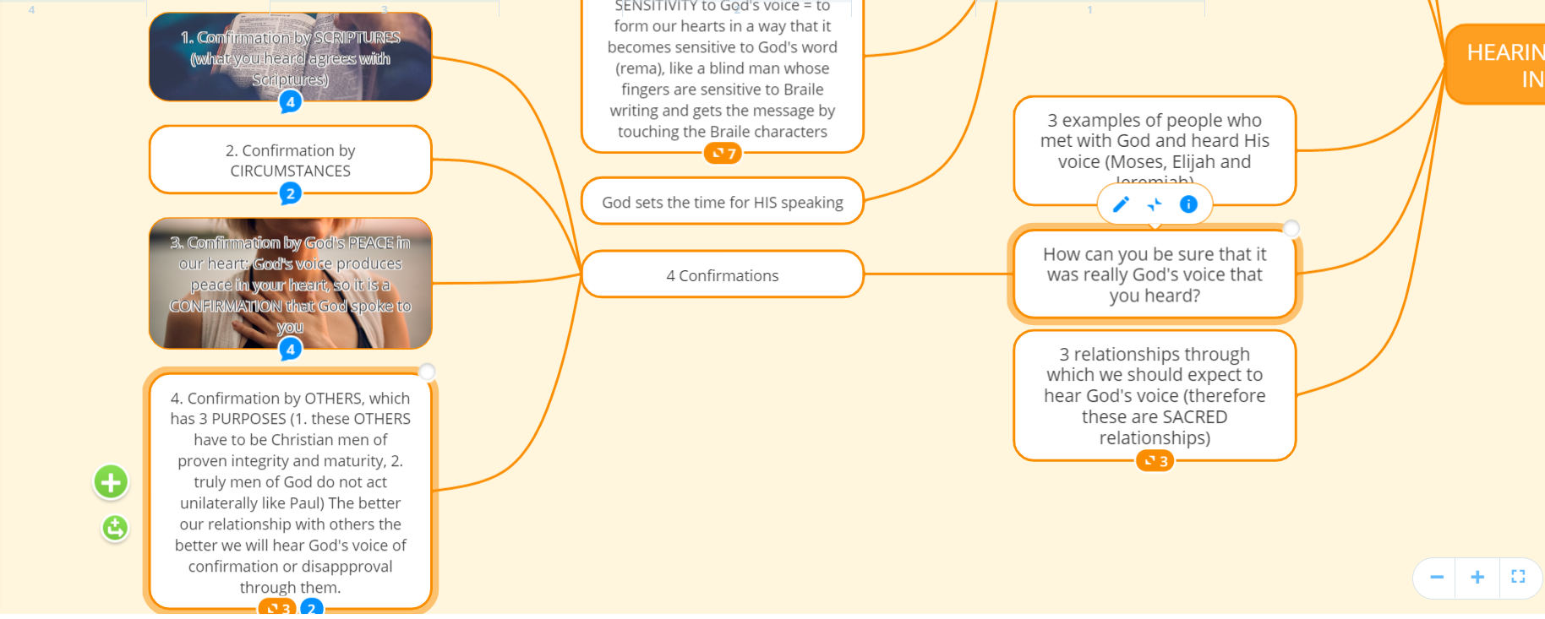

Slide 33
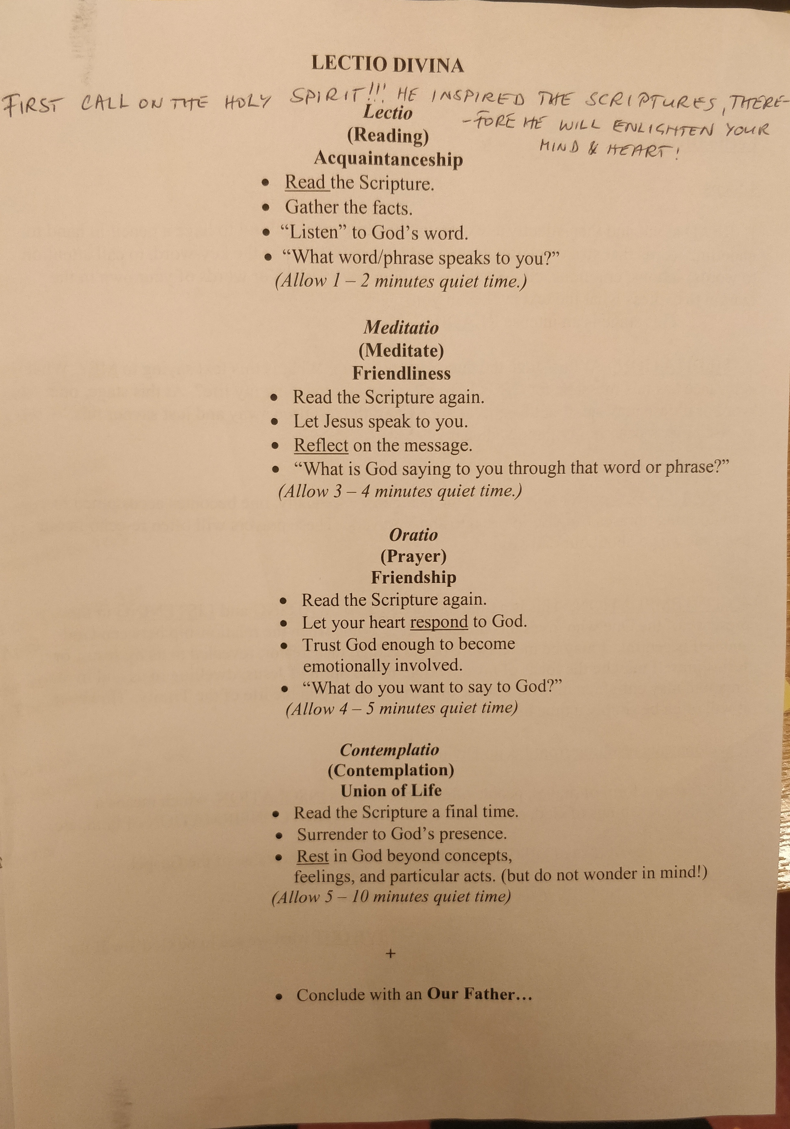
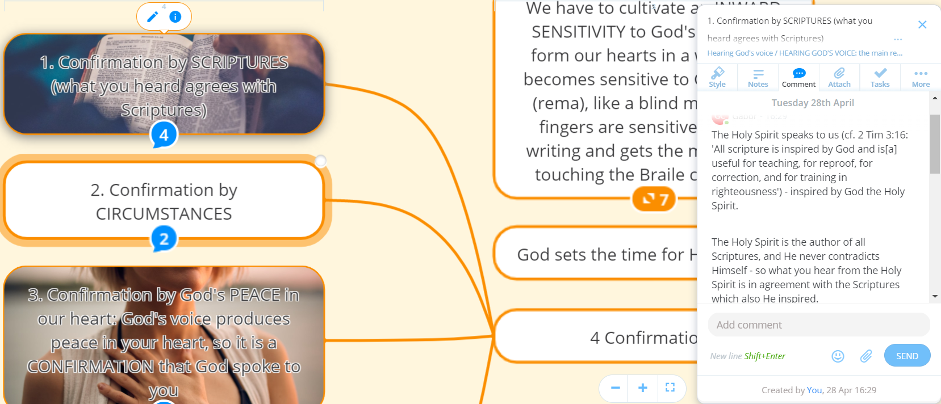
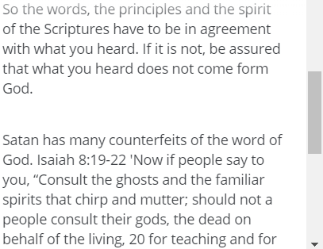
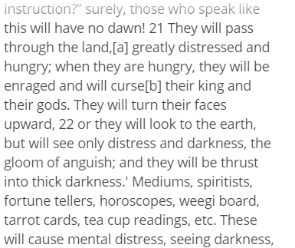
Lectio Divina is a well proven way of hearing God’s word through the Scriptures. Click the RIGHT ARROW on your keyboard to reveal a guide for Lectio Divina!

Slide 34
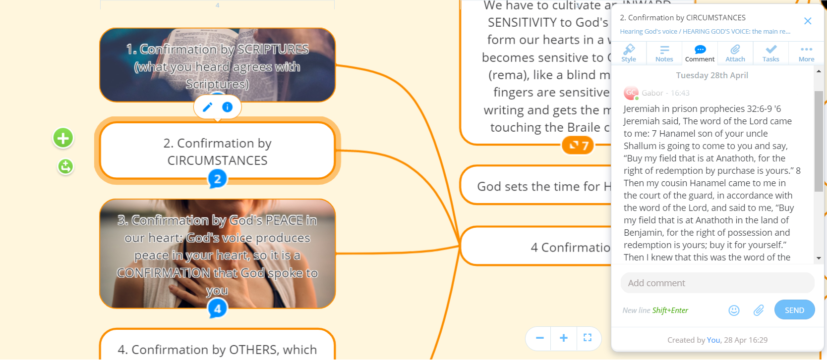

Slide 35
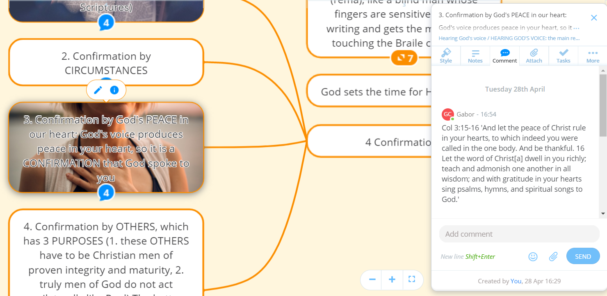
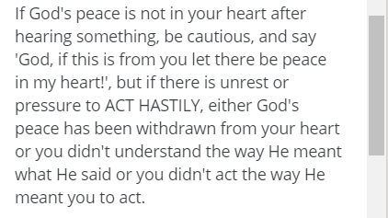
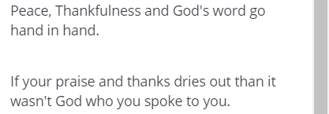

Slide 36
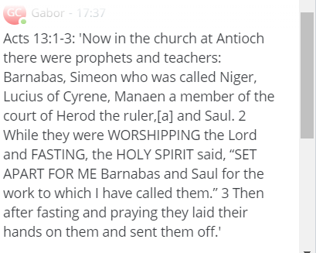
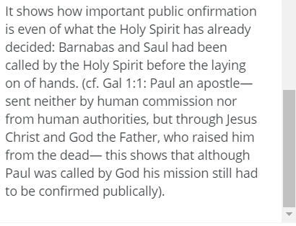

Slide 39
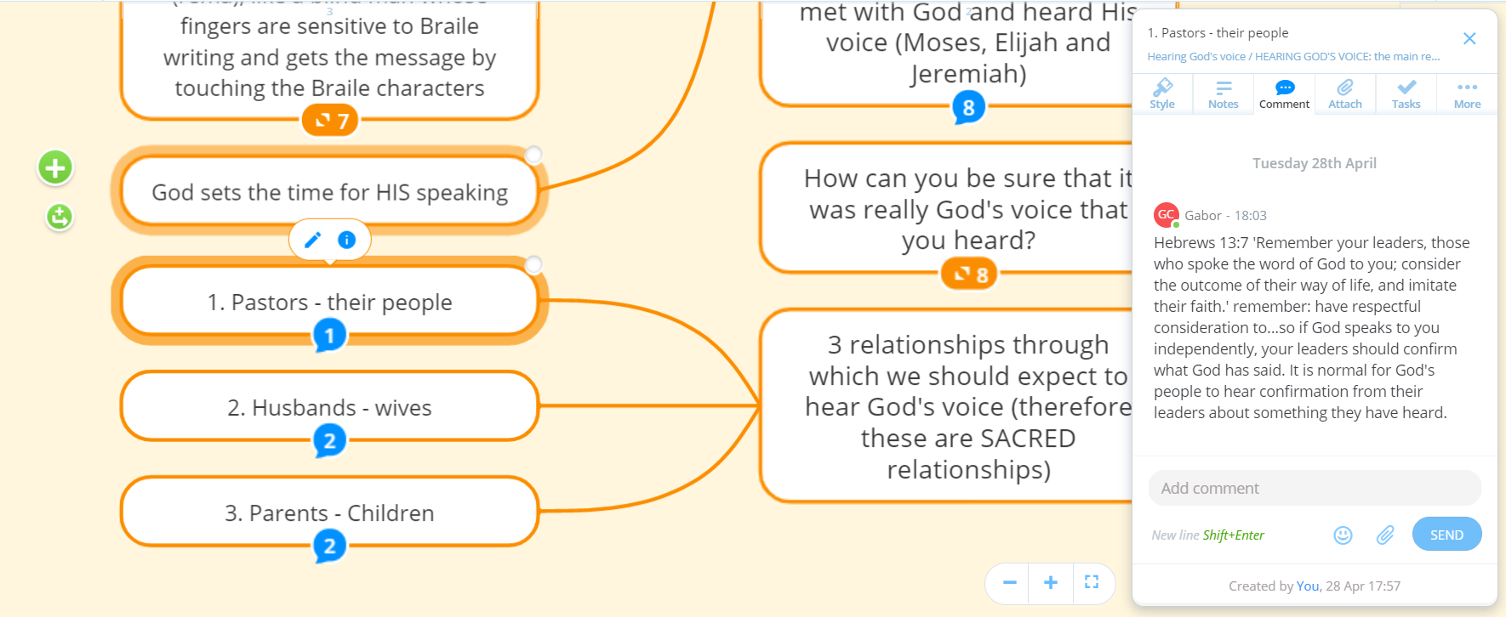
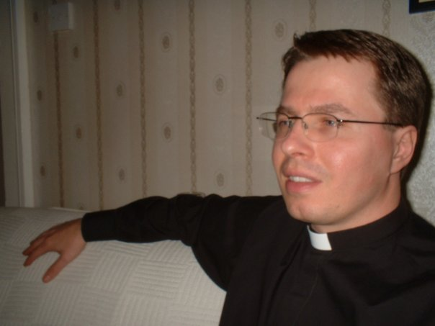

Slide 40
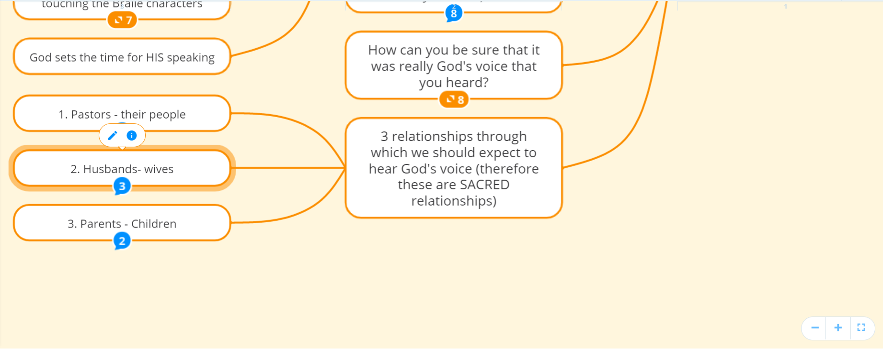
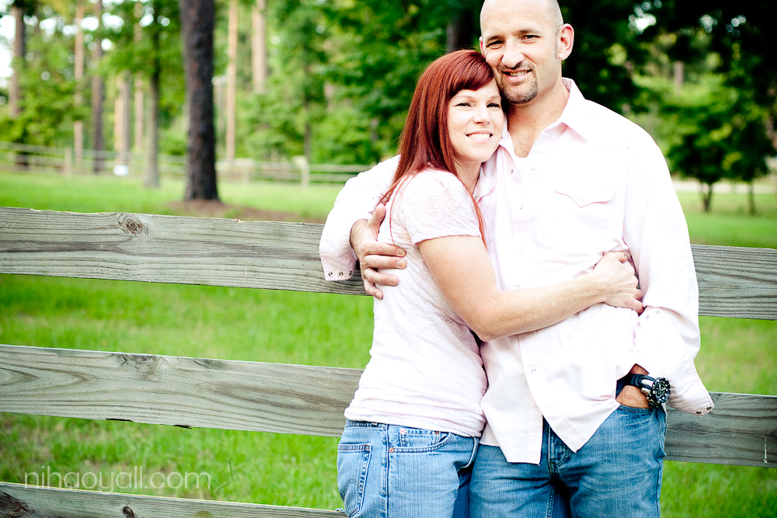
Ephesians 5:21-28 - '21And further, submit to one another out of reverence for Christ. 22For wives, this means submit to your husbands as to the Lord. 23For a husband is the head of his wife as Christ is the head of the church. He is the Saviour of his body, the church. 24As the church submits to Christ, so you wives should submit to your husbands in everything. 25For husbands, this means love your wives, just as Christ loved the church. He gave up his life for her 26to make her holy and clean, washed by the cleansing of God’s word.b 27He did this to present her to himself as a glorious church without a spot or wrinkle or any other blemish. Instead, she will be holy and without fault. 28In the same way, husbands ought to love their wives as they love their own bodies.'
It is dangerous when a wife pushes through her own agendas despite the husband's approval. It can lead to marriage breakdown. It is true also the other way around.
The ideal is when husbands and wives discern together God's voice for them, on the basis of what I have already mentioned previously. It is not impossible, and I have met a few couples who do that, especially when God's will is important for both of them.

Slide 41
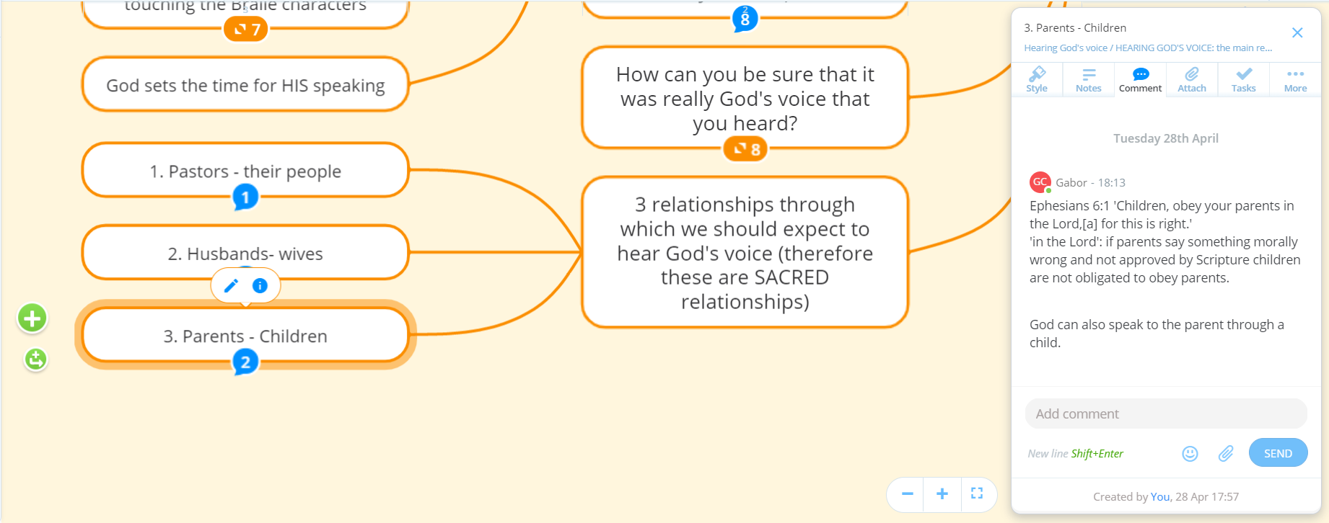

Slide 42
Please feel free to share this presentation and so help others also to hear God’s voice/word!
If you want to edit this presentation, please contact Fr. Gabor to grant access to editing.

