Slide 1
Christian Life in the World
Christian Life in the World

Slide 2
The Personal Christian Life (1)
The Personal Christian Life
Christ Carrying His Cross by Stanley Spencer

Slide 3
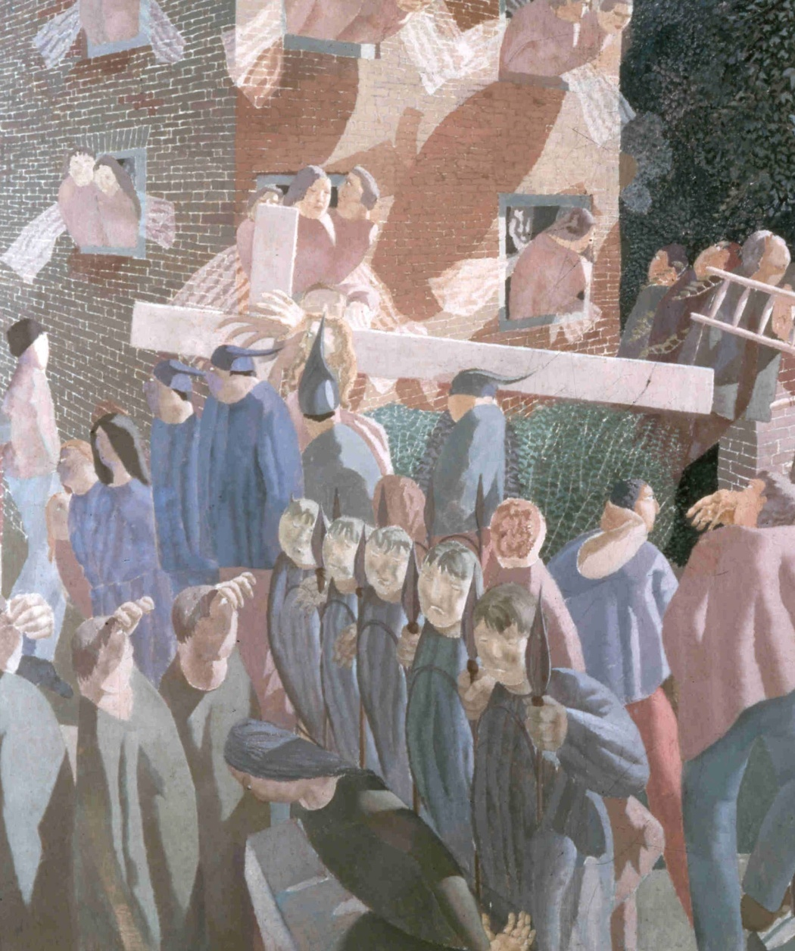
The Personal Christian Life (2)
The Personal Christian Life
The personal Christian life is the conforming of one’s life to the pattern of Jesus Christ.
KEY DEFINITION

Slide 4
The Personal Christian Life (3)

Slide 5
The Personal Christian Life (4)
Jesus carries his cross
through Cookham High Street. The street becomes like the nave of a church.
This picture represents the way that the Christian life is often lived out in quiet but constant faithfulness amid the business of daily secular life. Beneath the surface of everyday life a miraculous and extra-ordinary Christian reality can be found.
Carpenters and workmen
are associated with Christ as they follow him in carrying ladders.

Slide 6
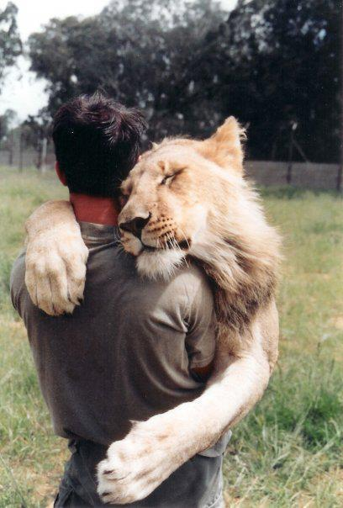
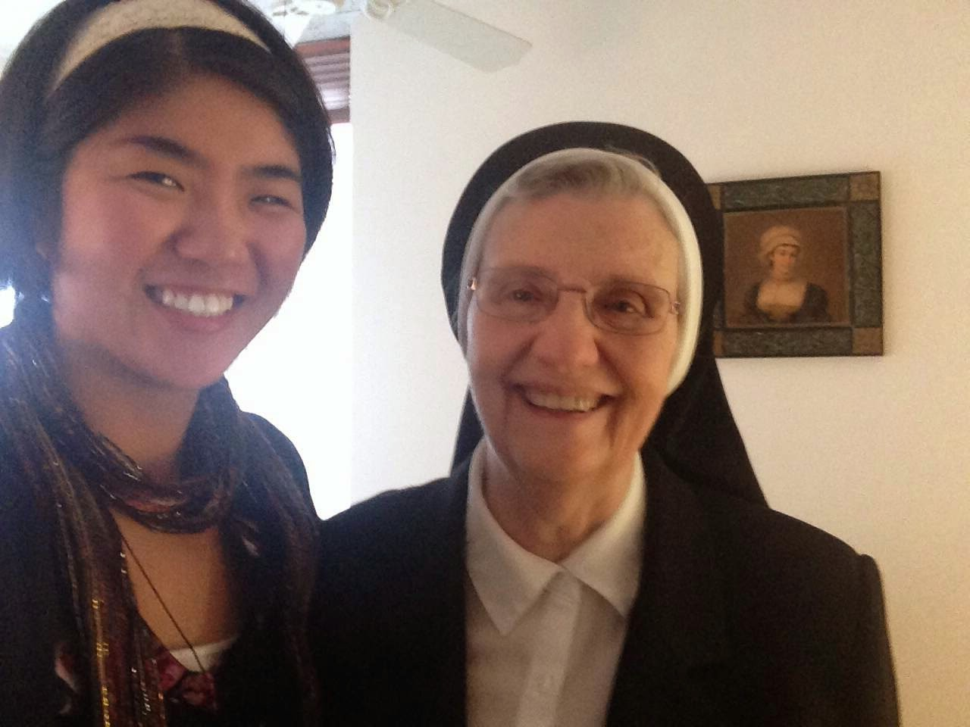
A trusted guide (a Christian friend, family member) A spiritual director (priest, bishop, religious, trained lay person) may be helpful in developing a plan of action

Slide 7
Personal prayer life (1)
Personal prayer life
The Angelus by Jean-François Millet
This picture shows how prayer can be incorporated into our daily labours.

Slide 8
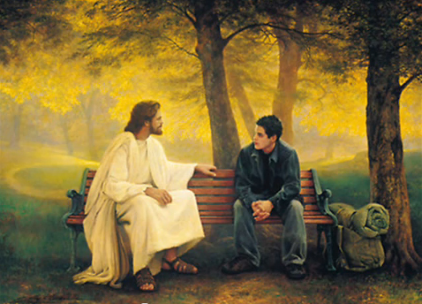
How important is it to be faithful to daily prayer and why? ‘Apart from me you can do nothing.’ (Jn 15:5)

Slide 9
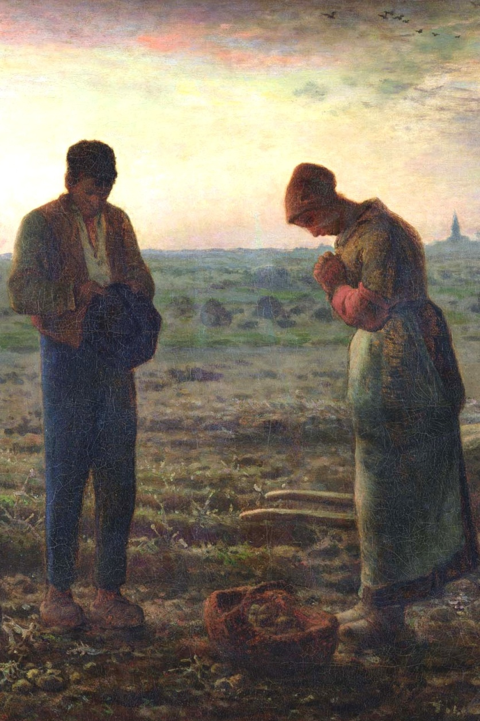
Personal prayer life (2)
Personal prayer life
Fidelity to a pattern of daily prayer is essential to the effective living of the Christian life.
While the prayer of each Christian will reflect his or her particular circumstances and needs, the Church and her saints give us certain common principles of daily prayer.

Slide 10
When is a good time for you to pray ?

Slide 11
Personal prayer life (3)
Personal prayer life
Pray each day, preferably at set times and especially at the beginning and end of the day.
Learn some of the most important prayers, so that they can be recalled easily at any time.
Practice clearing the mind of distractions and turning to God even in daily work.

Slide 12
Personal prayer life (4)
Personal prayer life
It is better to begin by devoting short daily periods to prayer than to pray for long periods but to do so only occasionally.

Slide 13
Personal knowledge (1)
Personal knowledge
Saint Jerome in his Study by Antonello da Messina
St Jerome reminds us of the need to spend time increasing our knowledge of the faith.

Slide 14
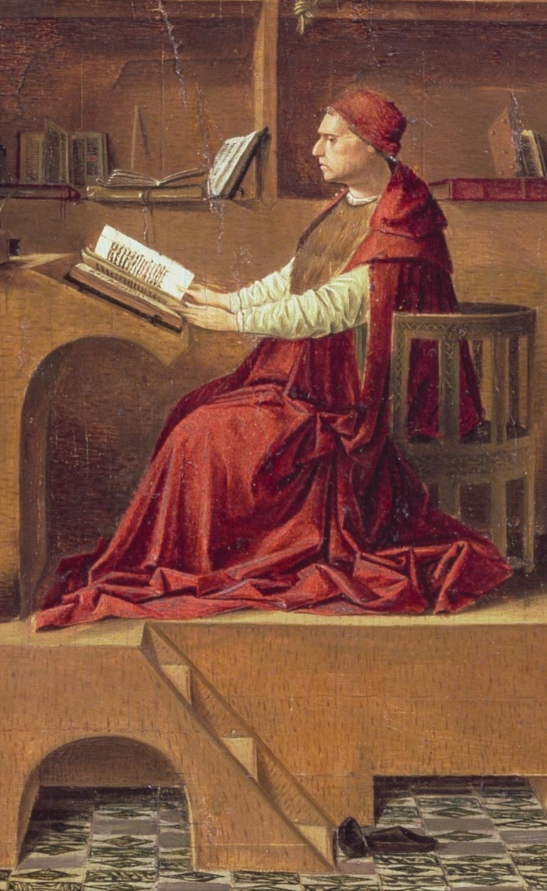
Personal knowledge (2)
Personal knowledge
Knowledge is essential to living the Christian life, because we cannot love what we do not know.
Knowledge of holy things (Bible, liturgy, etc.) helps to deepen your love for God.

Slide 15
Personal knowledge (3)
Personal knowledge
It is therefore helpful to our personal development to:
Set aside time for reading Scripture and other books about the faith.
Share and discuss the faith with others, particularly priests and teachers.
Attend a catechetical course and make use of other Catholic educational resources.

Slide 16
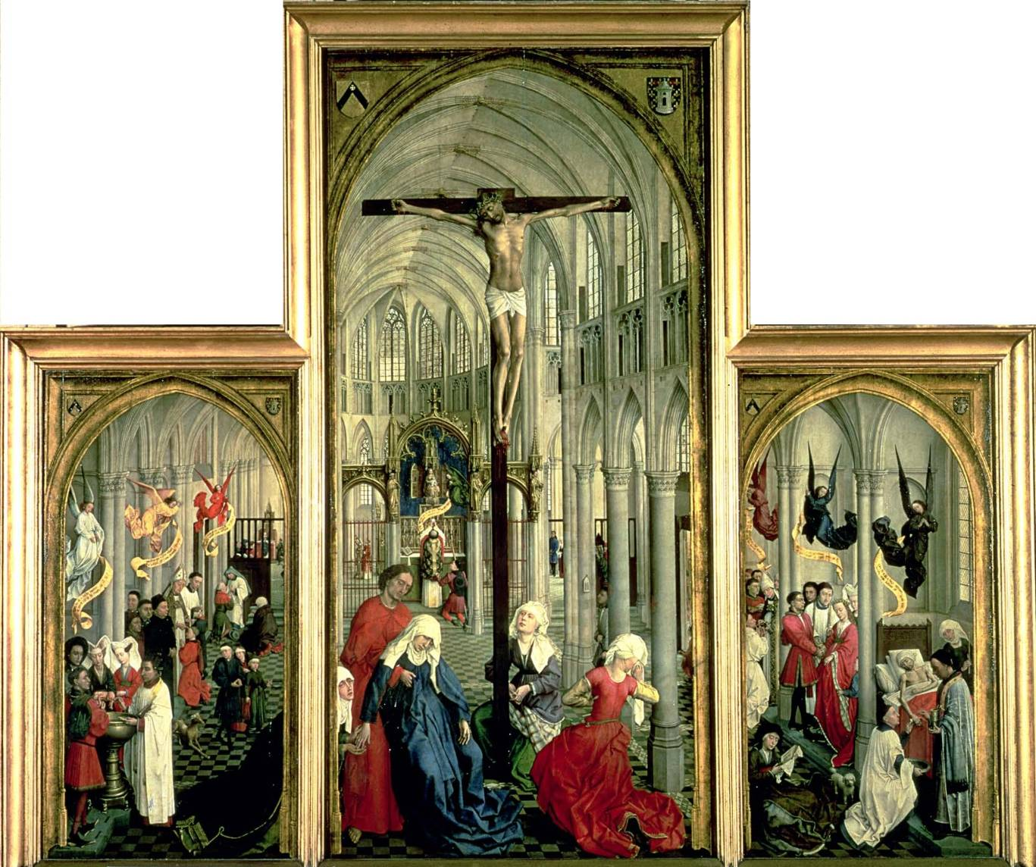
Personal sacramental life (1)
Personal sacramental life
The Seven Sacraments by Weyden

Slide 17
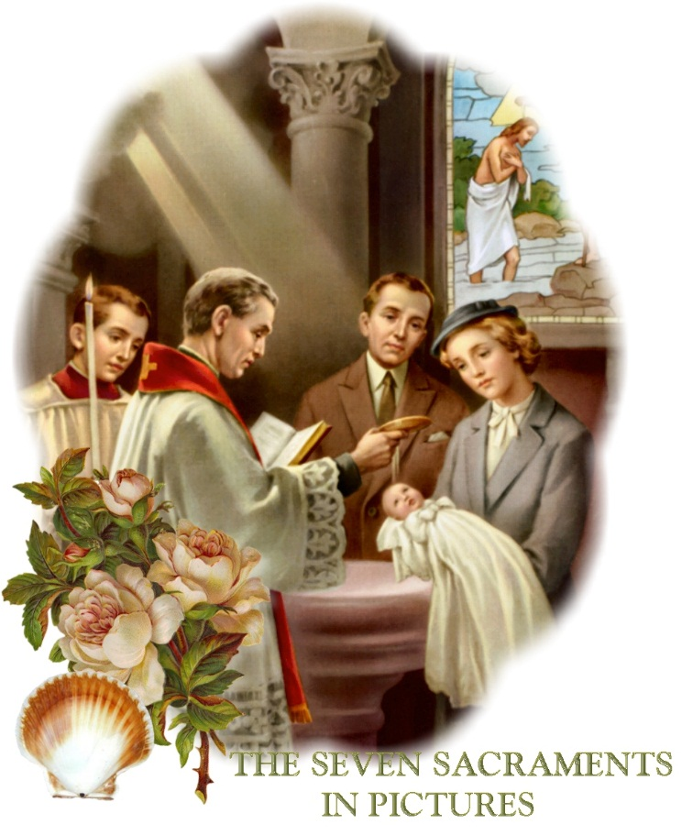
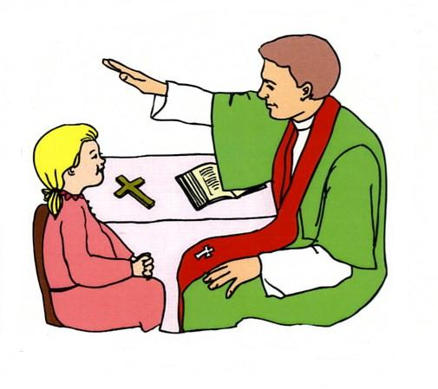
How can you get more out of the Sacraments (eg. Mass, confession)?
Personal sacramental life

Slide 18
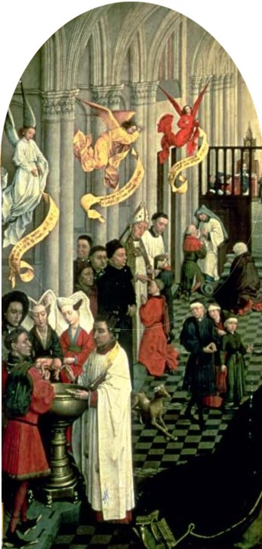
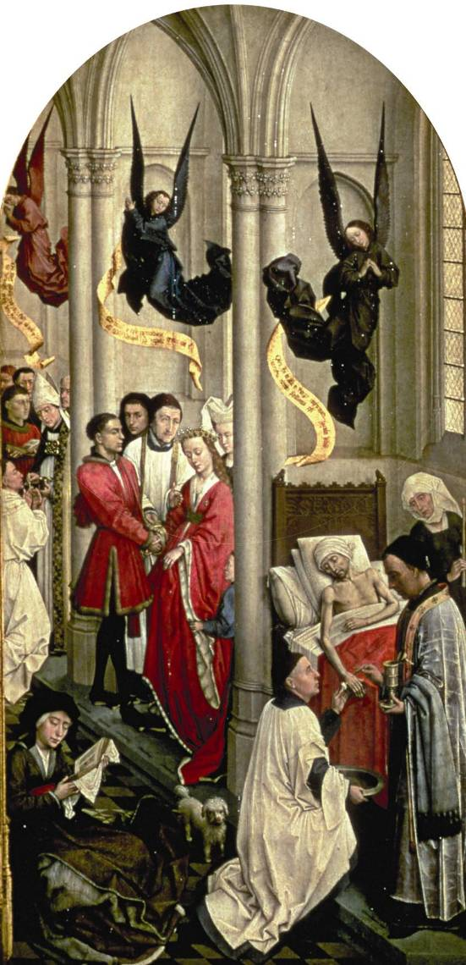
Personal sacramental life (2)
Personal sacramental life
Since the sacraments begin and sustain the Christian life it is beneficial to go to Mass and Confession more often than is obligatory.
Daily Mass and monthly Confession are recommended practices.

Slide 19
Personal moral life (1)
Personal moral life
The Conversion of St Augustine by Gozzoli
Augustine was converted to Christianity after reading the Scriptures. He gave up his immoral life and found true joy in following Christ.

Slide 20
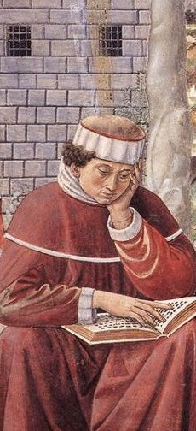
Personal moral life (2)
Personal moral life
Personal morality is essential to living in an authentic Christian way and remaining in God’s grace.
God calls us to follow his will even in our smallest actions and to offer daily sacrifices for ourselves and others.

Slide 21
Personal moral life (2)
Personal moral life
St. Augustine lived an immoral life for many years before he converted to Christ, which teaches us that we do not only come to church or the sacraments, which are visible signs of Christ, because we are perfect, but because we want to become perfect in love.

Slide 22
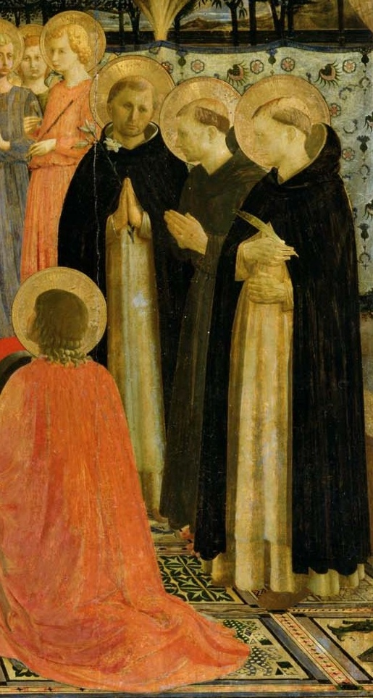
Personal moral life (3)
Personal moral life
The lives of the saints teach us to:
Ask God for the grace each day to grow in virtue and avoid vice.
Make an examination of conscience and moral resolutions at the end of each day.
Make specific acts of charity and sacrifice, such as fasting.
Dominicans in the San Marco Altarpiece by Fra Angelico

Slide 23
The precepts of the Church (1)
The precepts of the Church
Christ handing the keys to St Peter by Pietro Perugino
Through the power of binding and loosing, given by Christ to St Peter, the Church sets out a small number of precepts that are binding on all the faithful.

Slide 24
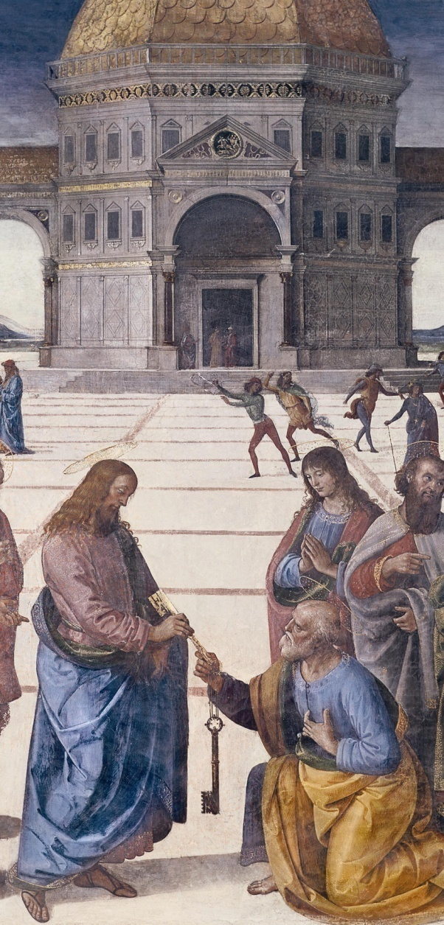
The precepts of the Church (2)
The precepts of the Church
THE PRECEPTS OF THE CHURCH: THE OBLIGATORY MINIMUM FOR THE PERSONAL CHRISTIAN LIFE
1. You need to attend Mass on Sundays and holy days of obligation and rest from servile labour.
2. You need to confess your sins (receive the sacrament of Confession) at least once a year.
3. You need to receive the sacrament of the Eucharist (Holy Communion) at least during the Easter season.

Slide 25
The precepts of the Church (3)
The precepts of the Church
THE PRECEPTS OF THE CHURCH: THE OBLIGATORY MINIMUM FOR THE PERSONAL CHRISTIAN LIFE
4. You shall observe the days of fasting and abstinence established by the Church.
5. You shall help to provide for the needs of the Church (according to your ability)
This list is taken from ccc. 2041-2043. Older lists sometimes add equally important precepts listed elsewhere in the Catechism: to obey the laws of the Church concerning Marriage and participate in the Church's mission of the evangelisation of souls.
WITHOUT THESE PRECEPTS SOONER OR LATER WE FALL AWAY FROM THE FAITH!

Slide 26
Summary Activities I
Summary Activities I
Please select an activity or go immediately to part II of the presentation
Summary
Questions to reinforce key points
Discussion questions
Practical activities
Presentation Part II

Slide 27
Summary I
Summary
The personal Christian life is the conforming of one’s life to the pattern of Jesus Christ.
Key aspects of the personal Christian life are fidelity to a pattern of daily prayer, increasing knowledge of the faith, use of the sacraments and personal morality assisted by God’s grace.
The precepts of the Church define the minimum obligations the Church makes on the personal Christian life.
Activities Menu
Presentation Part II

Slide 28
Questions to reinforce key points I
Questions to reinforce key points
What are the precepts of the Church?
1
Attend Mass on Sundays and holy days and rest from servile labour.
Receive the sacrament of Confession at least once a year.
Receive Holy Communion at least during the Easter season.
Observe the days of fasting and abstinence established by the Church.
Provide for the needs of the Church (according to one’s ability).
2
3
4
5
Click on a box to reveal one of the answers
Activities Menu
Presentation Part II

Slide 29
Discussion questions I
Discussion questions
Select one or more of the following:
Discuss what is most important in living out the personal Christian life.
Discuss some personal experiences of living out one or more of the aspects of the personal Christian life.
Activities Menu
Presentation Part II

Slide 30
Practical activities I
Practical activities
Select one or more of the following:
Read Matthew 5:1-48 from the Sermon on the Mount and note any practical implications for the personal Christian life.
Draw up a plan for the coming week that puts into practice some good resolutions for living out the personal Christian life.
Activities Menu
Presentation Part II

Slide 31
The Public Christian Life (1)
The Public Christian Life

Slide 32
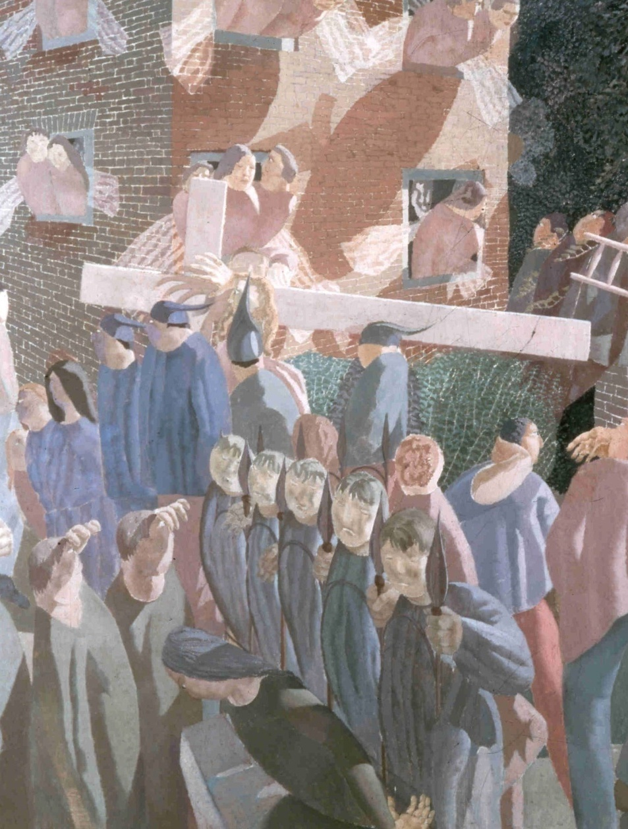
The Public Christian Life (2)
The Public Christian Life
The public Christian life is the conforming of one’s own family and society to the pattern of Jesus Christ.
KEY DEFINITION

Slide 33
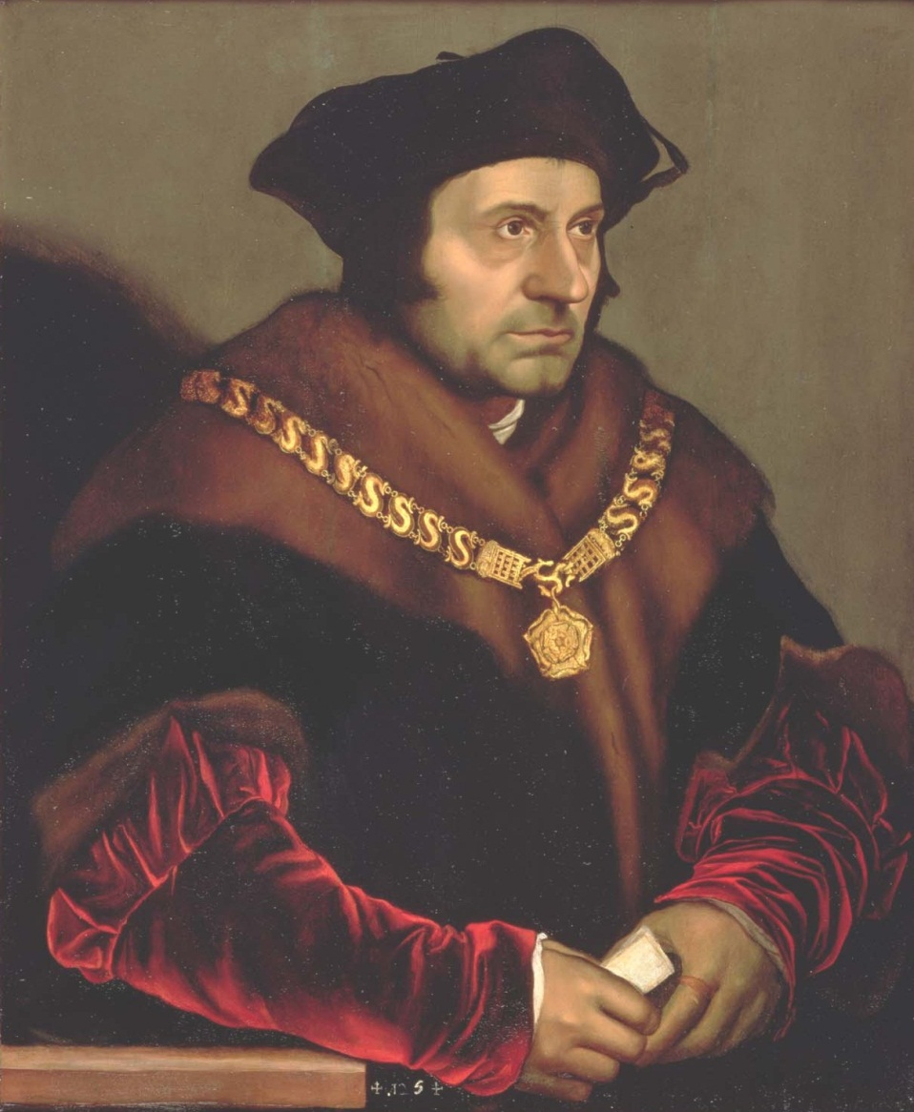
Christian Society (1)
Christian society
Thomas More by Holbein
St Thomas More, chancellor of England, was renowned for his consistent upholding of the principles of a good Christian society. He is the patron saint of statesmen.

Slide 34
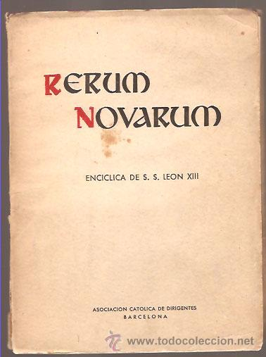
Following Christ has both a personal and a social aspect. Responsibility for our personal relationship with God Social actions based on what Christ wants from us to do or say.
Christian society

Slide 35
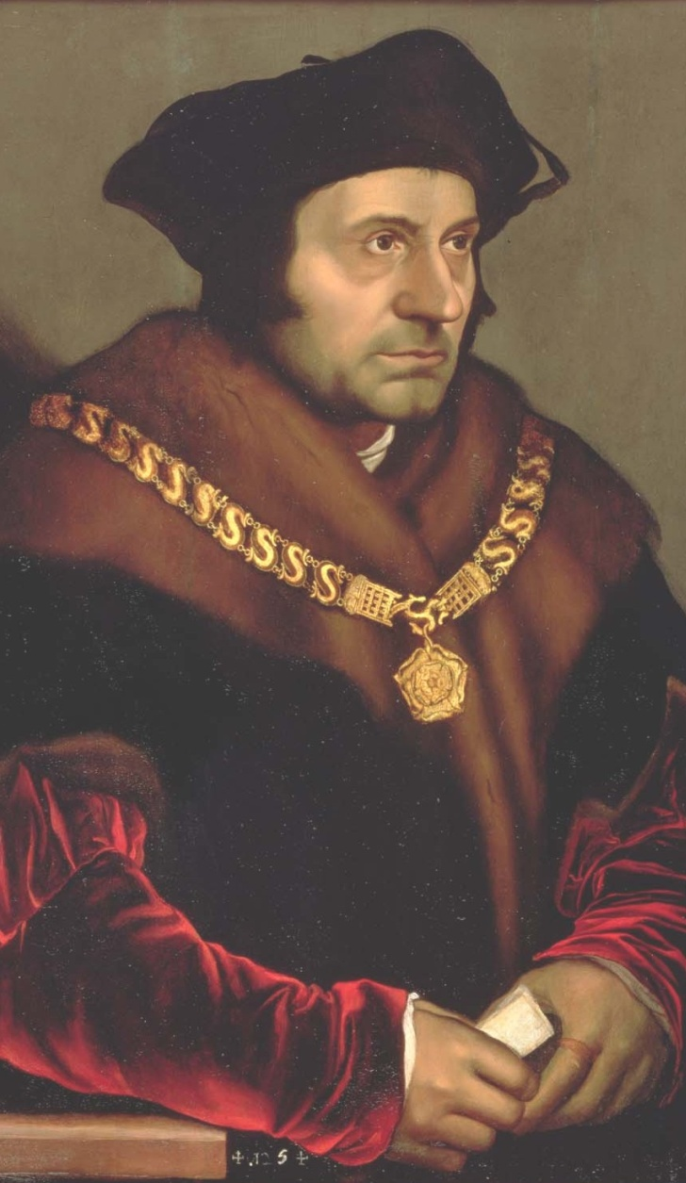
Christian Society (2)
Christian society
We are called to pray and work for a Christian society that:
respects natural law
upholds the dignity of all people
is conducive to evangelisation
encourages everyone to follow their God-given vocations

Slide 36
Vocation (1)
Vocation
The Calling of Saint Matthew by Caravaggio
Christ calls St Matthew away from his life as a tax collector to become an apostle.

Slide 37
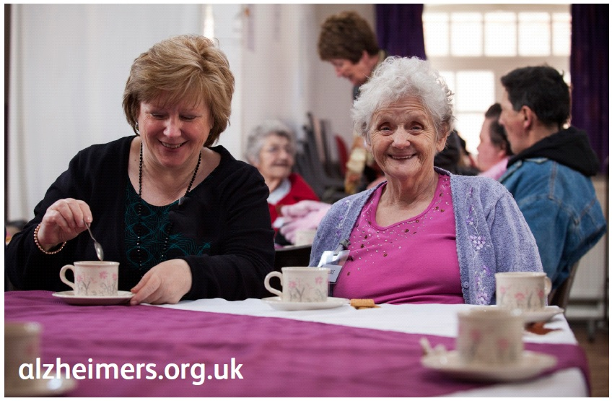
What do you feel God is calling you to do in society?

Slide 38
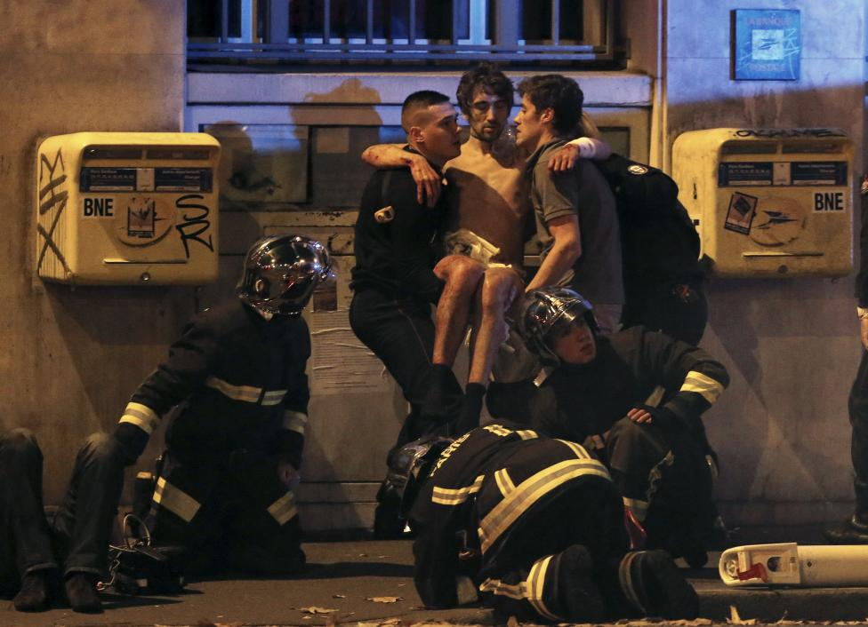
Every Christian is called to be a Saint

Slide 39
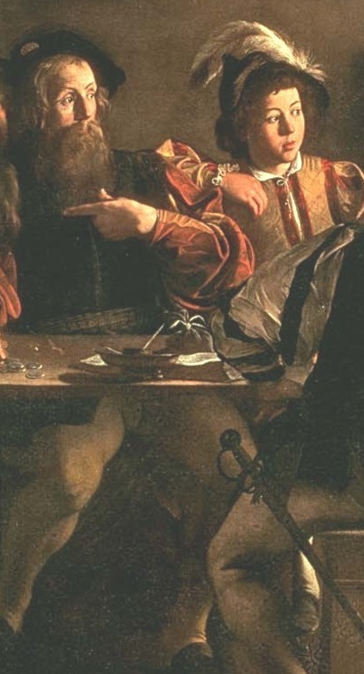
Vocation (2)
Vocation
Every human being is called to a particular kind of service.
Marriage is the vocation of most people, although some are called to remain single.
God also specifically calls some people to consecrate themselves in religious life or the priesthood.

Slide 40
Vocation (3)
Vocation
To discern and follow our vocation we need to:
Pray to discover God’s will for us
Examine our talents and the contemporary needs of the Church and the world
Pray for the strength to pursue our vocation when it has become clear to us

Slide 41
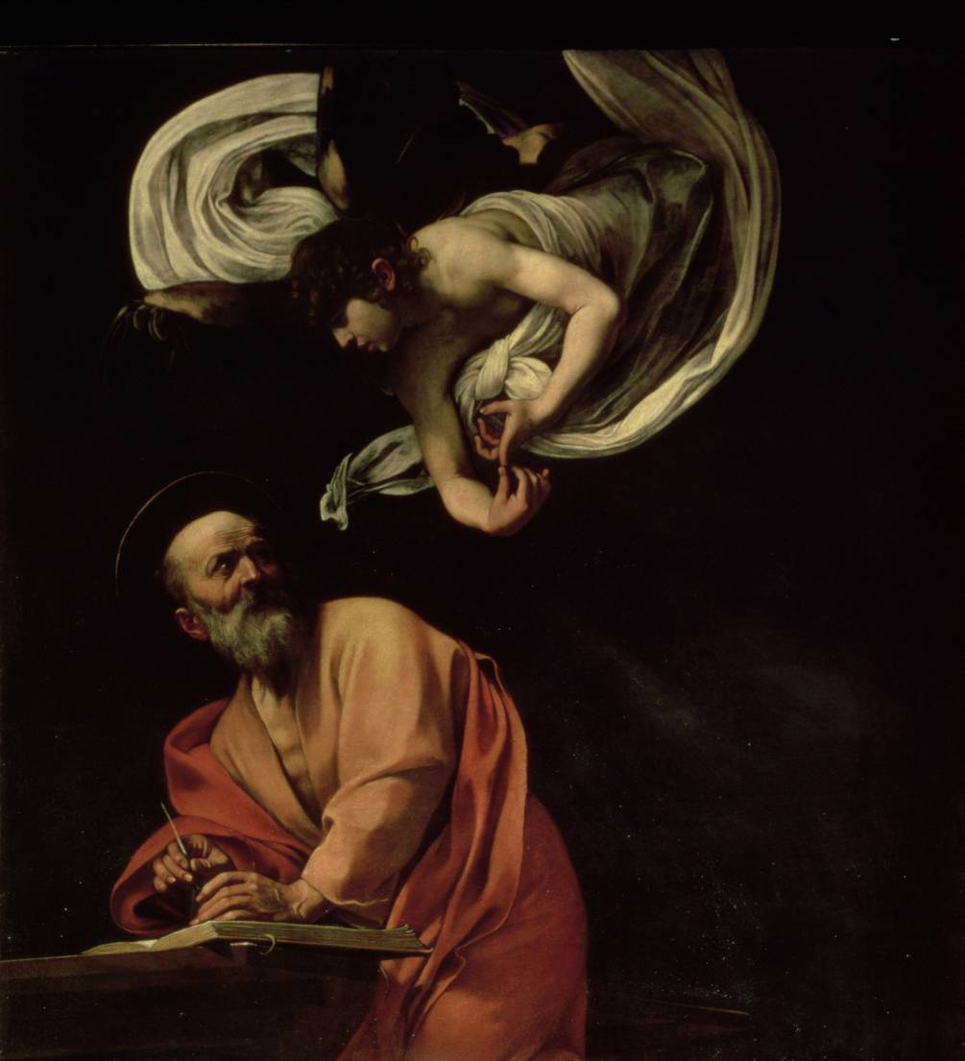
Evangelisation (1)
Evangelisation
Saint Matthew writing his Gospel by Caravaggio
St Matthew went out to the world to proclaim Christ and wrote the gospel that bears his name. He is, therefore, fittingly called an ‘evangelist’.

Slide 42
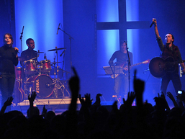
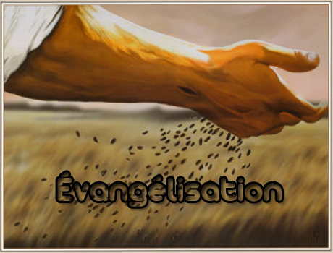
Our faith is a gift which is offered to everyone, and not only for certain types of people How could you help others to come to faith? https://www.youtube.com/watch?v=wp1ozgFz7Ac

Slide 43
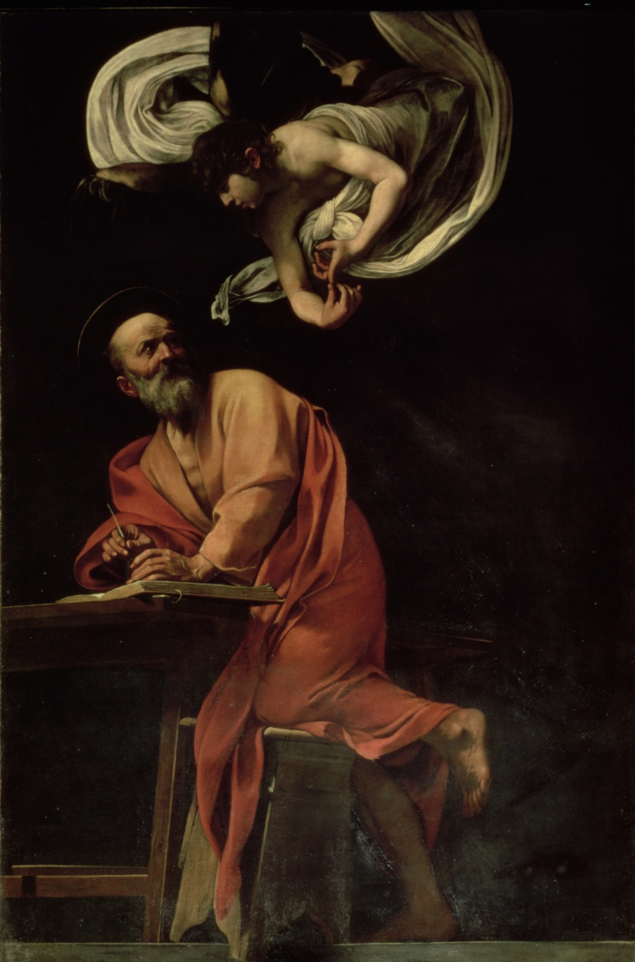
Evangelisation (2)
Evangelisation
We have a responsibility to proclaim the Gospel to others, a proclamation which is called ‘evangelisation’.

Slide 44
Evangelisation (3)
Evangelisation
We evangelise in a variety of ways, such as:
Praying for the conversion and spiritual growth of others.
Teaching the faith to our families and friends, where most evangelisation takes place.
Being ready to introduce others to the faith in a variety of ways, such as conversations, books and above all by good example.

Slide 45
Acts of charity (1)
Acts of charity
Healing of the Cripple and Raising of Tabatha by Masolino da Panicale
Tabatha was famous for her acts of Christian charity. Here she herself receives an extraordinary work of mercy from St Peter.

Slide 46
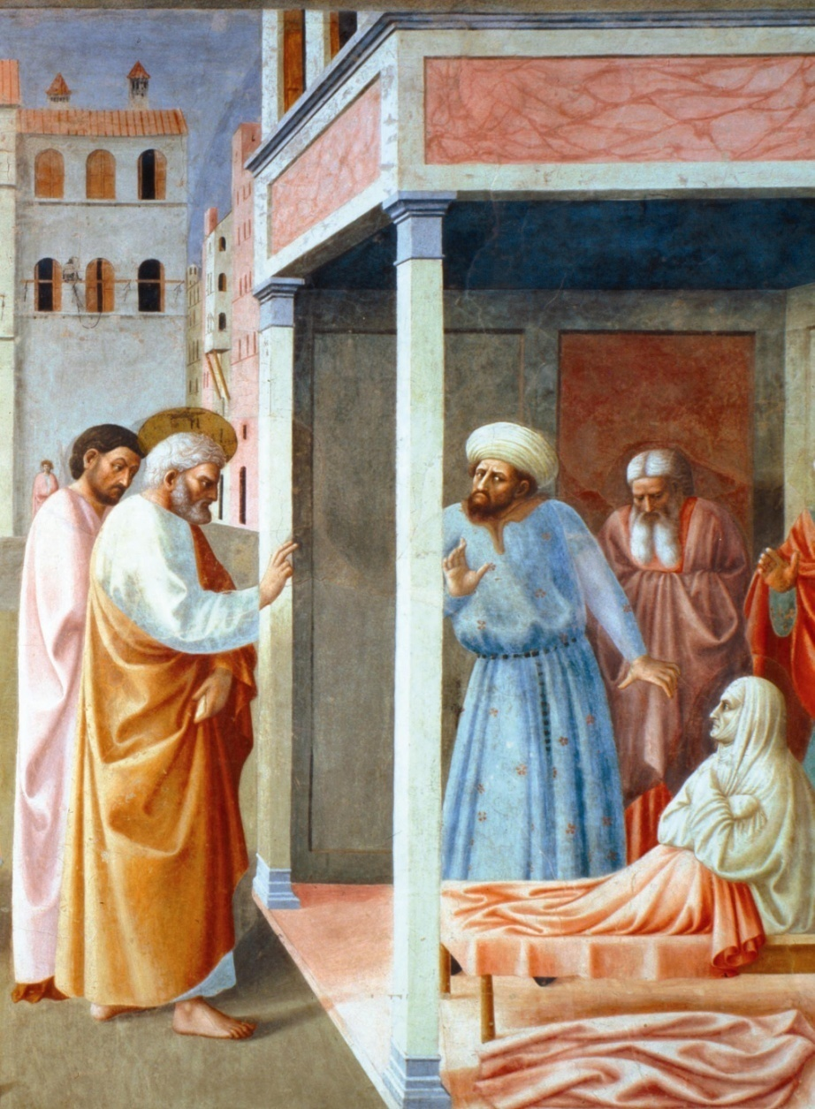
Acts of charity (2)
Acts of charity
We are commanded by Christ to practice charity in Christian living, in particular, the practice of the works of mercy promotes Christian justice and true peace in society.
There are seven principal corporal and seven principal spiritual works of mercy.

Slide 47
Acts of charity (3)
Acts of charity
CORPORAL WORKS OF MERCY

Slide 48
Acts of charity (4)
Acts of charity
CORPORAL WORKS OF MERCY
Feed the hungry
Give drink to the thirsty
Clothe the naked
Harbour the homeless
Visit the sick
Visit the imprisoned
Bury the dead

Slide 49
Acts of charity (5)
Acts of charity
SPIRITUAL WORKS OF MERCY

Slide 50
Acts of charity (6)
Acts of charity
SPIRITUAL WORKS OF MERCY
Convert the sinner
Instruct the ignorant
Counsel the doubtful
Comfort the sorrowful
Bear wrongs patiently
Forgive injustice
Pray for the living and dead

Slide 51
Challenging the ‘culture of death’ (1)
Challenging the ‘culture of death’
Christ in Limbo by Fra Angelico
Jesus freed the souls of the dead through his Paschal Mystery. We are called to join him in defeating the ‘culture of death’ through his cross and Resurrection.

Slide 52
The following explanations are not exhaustive. Further study is required to fully understand the Church’s teaching on them.
Challenging the ‘culture of death’

Slide 53
Challenging the ‘culture of death’ (2)
Challenging the ‘culture of death’
 | Abortion
“The fifth commandment forbids as gravely contrary to the moral law ... direct abortion, willed as an end or a means, as well as cooperation in it.” “… from the moment of his or her conception, the human being must be absolutely respected and protected …” Compendium of the Catechism Question 470
What is this and why does it need to be challenged?

Slide 54
Challenging the ‘culture of death’ (3)
Challenging the ‘culture of death’
 | Abortion
“The fifth commandment forbids as gravely contrary to the moral law ... direct abortion, willed as an end or a means, as well as cooperation in it.” “… from the moment of his or her conception, the human being must be absolutely respected and protected …” Compendium of the Catechism Question 470 |  | Abortion is the intentional killing of a child between conception and birth; it attacks the sanctity of a life made in the image of God.
What is this and why does it need to be challenged?

Slide 55
Challenging the ‘culture of death’ (4)
Challenging the ‘culture of death’
 | Euthanasia
“The fifth commandment forbids as gravely contrary to the moral law ... direct euthanasia, which consists in putting an end to the life of the handicapped, the sick, or those near death by an act or by the omission of a required action.” Compendium of the Catechism Question 470
What is this and why does it need to be challenged?

Slide 56
Challenging the ‘culture of death’ (5)
Challenging the ‘culture of death’
 | Euthanasia
“The fifth commandment forbids as gravely contrary to the moral law ... direct euthanasia, which consists in putting an end to the life of the handicapped, the sick, or those near death by an act or by the omission of a required action.” Compendium of the Catechism Question 470 |  | Euthanasia is killing as a false act of mercy, a practice that corrodes respect for the old and infirm and can soon become involuntary. Suicide is the intentional killing of oneself. Both practices hinder God’s completion of a life.
What is this and why does it need to be challenged?

Slide 57
Challenging the ‘culture of death’ (6)
Challenging the ‘culture of death’
 | Cloning and IVF
“They are immoral because they dissociate procreation from the act with which the spouses give themselves to each other and so introduce the domination of technology over the origin and destiny of the human person.” Compendium of the Catechism (on artificial fertilization) Question 499
What are these and why do they need to be challenged?

Slide 58
Challenging the ‘culture of death’ (7)
Challenging the ‘culture of death’
 | Cloning and IVF
“They are immoral because they dissociate procreation from the act with which the spouses give themselves to each other and so introduce the domination of technology over the origin and destiny of the human person.” Compendium of the Catechism (on artificial fertilization) Question 499 |  | Human cloning is the artificial duplication of human beings. ‘In vitro fertilisation’ (IVF) is artificial non-sexual procreation. They attack the dignity of the child, the sanctity of natural procreation and lead in practice to the mass destruction of embryos.
What are these and why do they need to be challenged?

Slide 59
Challenging the ‘culture of death’ (8)
Challenging the ‘culture of death’
 | Divorce, re-marriage and co-habitation
“The marital union of man and woman … is by its very nature ordered to the communion and good of the couple and the generation and education of children … According to the original divine plan this conjugal union is indissoluble, as Jesus Christ affirmed.” Compendium of the Catechism Question 338
Why do these need to be challenged?

Slide 60
Challenging the ‘culture of death’ (9)
Challenging the ‘culture of death’
 | Divorce, re-marriage and co-habitation
“The marital union of man and woman … is by its very nature ordered to the communion and good of the couple and the generation and education of children … According to the original divine plan this conjugal union is indissoluble, as Jesus Christ affirmed.” Compendium of the Catechism Question 338 |  | Divorce, re-marriage and cohabitation all destabilise and devalue the dignity of Marriage and the family as the natural foundations of society.
Why do these need to be challenged?

Slide 61
Challenging the ‘culture of death’ (10)
Challenging the ‘culture of death’
 | Artificial contraception; homosexual activity
“No one may break the inseparable connection which God has established between these two meanings [unitive and procreative] of the conjugal act by excluding one or the other of them.” Compendium of the Catechism Question 338 “Homosexual acts … close the sexual act to the gift of life. Under no circumstances can they be approved.” Catechism of the Catholic Church par. 2357
Why do these need to be challenged?

Slide 62
Challenging the ‘culture of death’ (11)
Challenging the ‘culture of death’
 | Artificial contraception; homosexual activity
“No one may break the inseparable connection which God has established between these two meanings [unitive and procreative] of the conjugal act by excluding one or the other of them.” Compendium of the Catechism Question 338 “Homosexual acts … close the sexual act to the gift of life. Under no circumstances can they be approved.” Catechism of the Catholic Church par. 2357 |  | Artificial contraception and homosexual activity separate the gift of human sexuality from procreation or from married love altogether, contributing to a sexually irresponsible and sterile culture.
Why do these need to be challenged?

Slide 63
Summary Activities II
Summary Activities II
Please select an activity or go immediately to the concluding prayer
Summary
Questions to reinforce key points
Discussion questions
Practical activities
Concluding Prayer

Slide 64
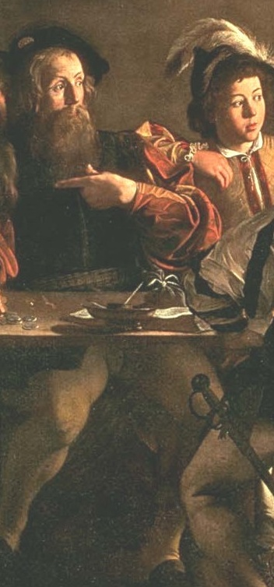
Summary II
Summary
The public Christian life is the conforming of one’s own family and society to the pattern of Jesus Christ.
We are called to pray and work for a Christian society that respects natural law, upholds the dignity of all people, is conducive to evangelisation and encourages everyone to follow their God-given vocations.
We are also called to performs acts of charity and to resist the practices of the modern ‘culture of death’, including abortion, IVF and euthanasia, divorce, co-habitation, artificial contraception and homosexual activity.
Activities Menu
Concluding Prayer

Slide 65
Questions to reinforce key points II
Questions to reinforce key points
What are the seven spiritual works of mercy?
1
Convert the sinner
Instruct the ignorant
Counsel the doubtful
Comfort the sorrowful
Bear wrongs patiently
Forgive injustice
Pray for the living and dead
2
3
4
5
6
7
Click on a box to reveal one of the answers
Activities Menu
Concluding Prayer

Slide 66
Discussion questions II
Discussion questions
Select one or more of the following:
Discuss some personal experiences of living the public Christian life.
Discuss what a truly Christian society might be like.
Discuss how we can promote vocations and evangelisation.
Discuss ways in which a Christian can challenge the ‘culture of death’.
Activities Menu
Concluding Prayer

Slide 67
Practical activities II
Practical activities
Select one or more of the following:
Write down some ideas for putting into practice one or more of the corporal or spiritual works of mercy.
Based on some current issue, plan or write a courteous letter to an MP, councilor or newspaper challenging some aspect of the ‘culture of death’ in our society.
Activities Menu
Concluding Prayer

Slide 68
Final Prayer
Final Prayer
A Prayer of St Francis of Assisi
Lord, make me an instrument of Your peace. Where there is hatred, let me sow love; where there is injury, pardon; where there is doubt, faith; where there is despair, hope; where there is darkness, light; and where there is sadness, joy.
O, Divine Master, grant that I may not so much seek to be consoled as to console; to be understood as to understand; to be loved as to love; for it is in giving that we receive; it is in pardoning that we are pardoned; and it is in dying that we are born to eternal life.
Amen

